Slide 1
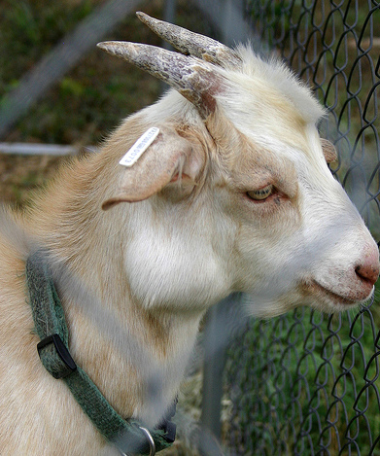
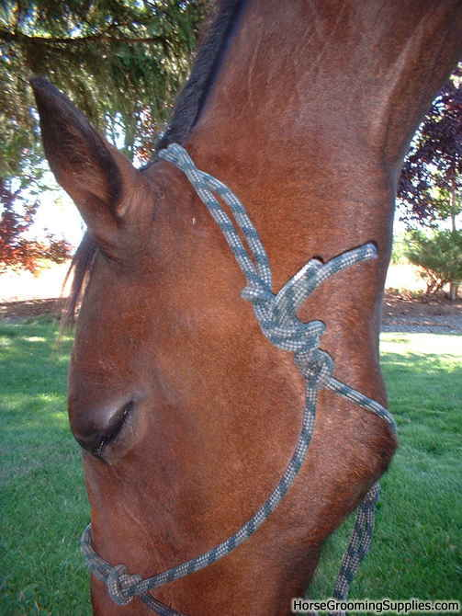
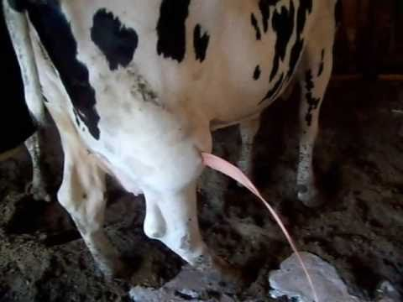
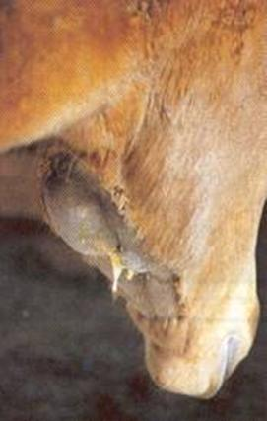
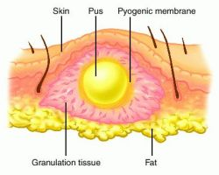
1-ABSCESS
Circumscribed swelling
Containing pus
Has signs of inflammation

Slide 2
Characters
1-Raised
2-Localized heat
3-Redness
4-Tenderness & pain
5-Pus format
6-Pointing, discharge Foul smell

Slide 3

Predilection seats
1-Equine sheep goats

Slide 4
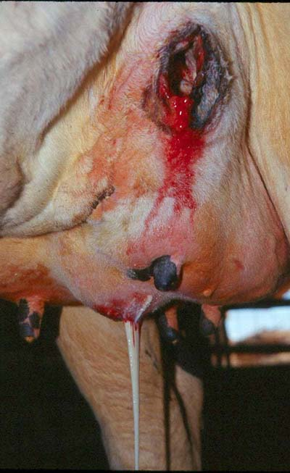
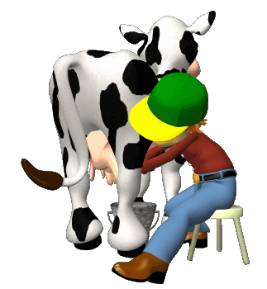
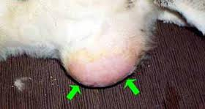
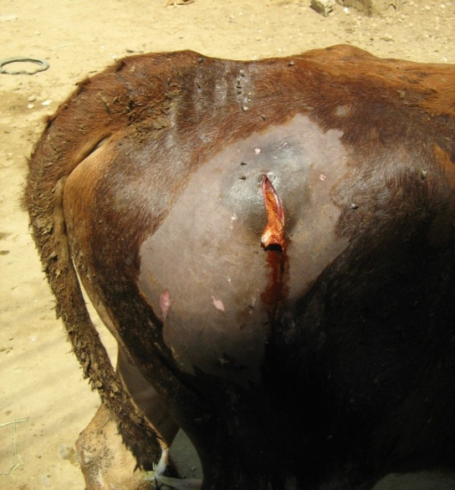
2-Cattle

Slide 5
Causes
1-Sharp foreign body
2-Wound
3-Injection
Pathogenesis

Slide 6
Classification
1-Septic and sterile
-Idiopathic
-Symptomatic
-Metastatic
-Critical
a-Acute or hot abscess
b-Chronic or cold abscess

Slide 7
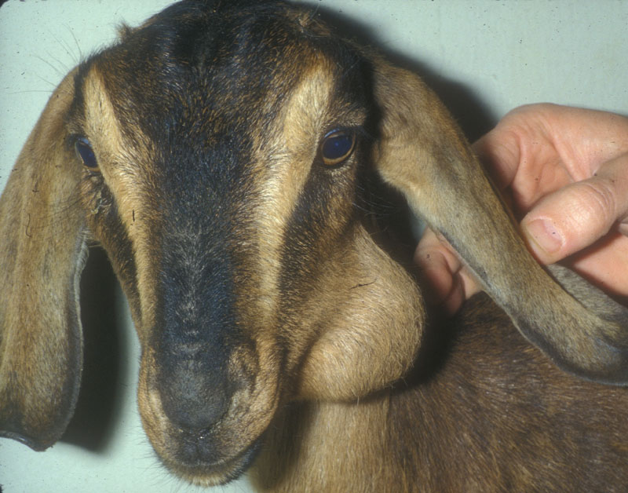
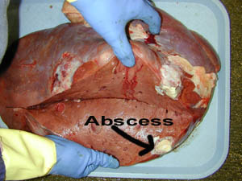
I-Acute or hot abscess
1-Superfecial
General signs of acute inflammation (swelling, redness, hotness and pain)
Fluctuated
Firm periphery
Points
Febrile condition
Interferes with normal function of surrounding organs
2-Deep

Slide 8
Diagnosis
1-History
2-Signs
3-Clinical examination
Exploratory puncture
4-Diff. diag.

Slide 9
Treatment (General Considerations)
1-The hair must be clipped off the area
2-Mature abscess must be lanced (Lancing is better for healing than rupture)
3-The pus must be drained from the abscess
4-After it is lanced, flushing of the pocket with antiseptic is critical to prevent the abscess from recurring
5-Keeping the incision opened for 7 to 10 days is required to flush out all of the infection

Slide 10
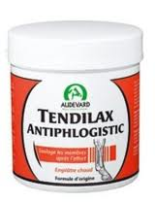
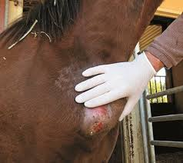
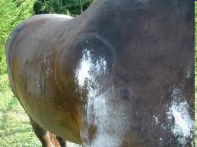
Treatment
1-Conservative Treatment
AB
AP
Flui
2-Ripening or Maturation

Slide 11
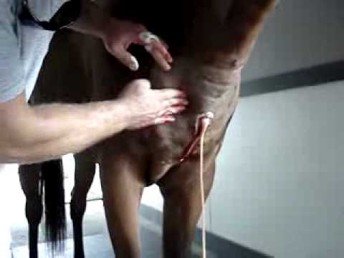

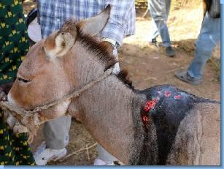
3-Evacuation and Drainage
Drain function

Slide 12
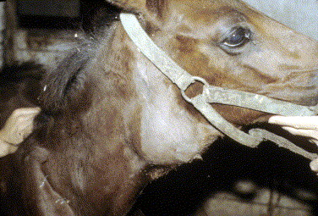
Critical Abscesses

Slide 13
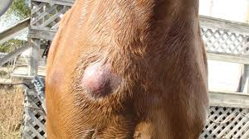
II-Chronic or Cold
Grow very slowly
Show very slight inflammatory reactions
Pain is either very slight or absent
1-Soft
2-Hard
soft surface
large amount pus
fibrous tissues
small amount pus
Treatment
maturation and
evacuation
Inspessiated
Capsulated

Slide 14
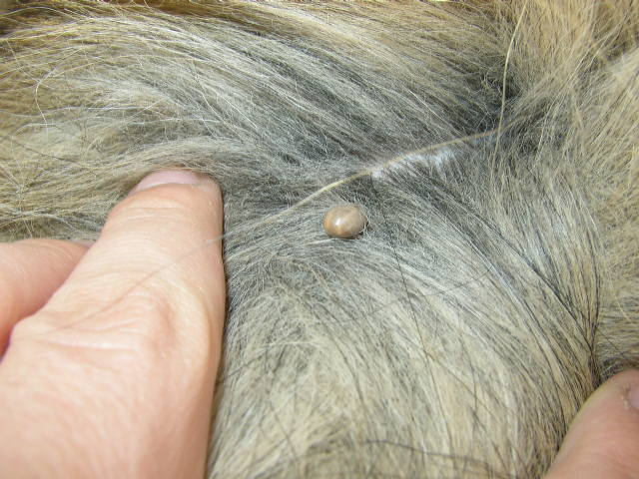
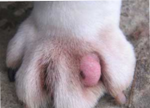
Special forms
I-Acne, Furuncle or Boil
Sebaceous gland
Single or multiple pustules
Size of a pea
Release grayish white pus
Grayish white core of necrotic tissue comes out when the pustule is compressed
Wash and apply an antiseptic Remove the necrotic core
Topical and systemic AB

Slide 15
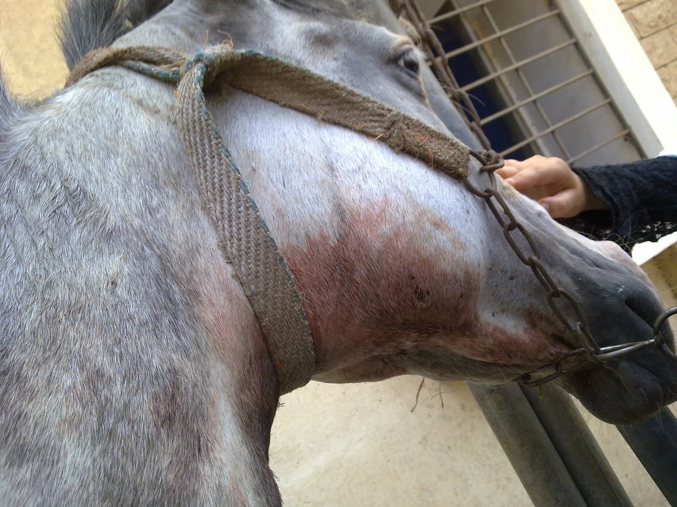
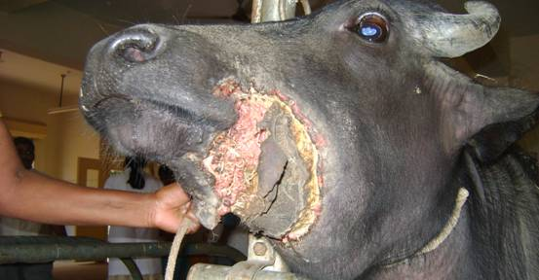
II-Phlegmon
Diffuse inflammatory swelling which fades gradually into the surrounding structures without any definite demarcation
1-Septic
2-Aseptic
1-Local diffuse swelling which fades gradually
2-Local tenderness and hotness
3-Lymph glands are usually inflamed
4-Body temperature rises and sharply fluctuates

Slide 16
Treatment
1-Keep the affected part in complete rest
2-Warm antiseptic fomentation, antiphlogestic poultices
3-If the phlegmon is so voluminous, (scarification)
4-Administration of systemic antibiotics

Slide 17
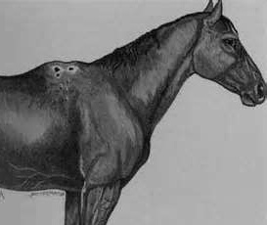
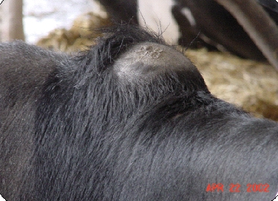
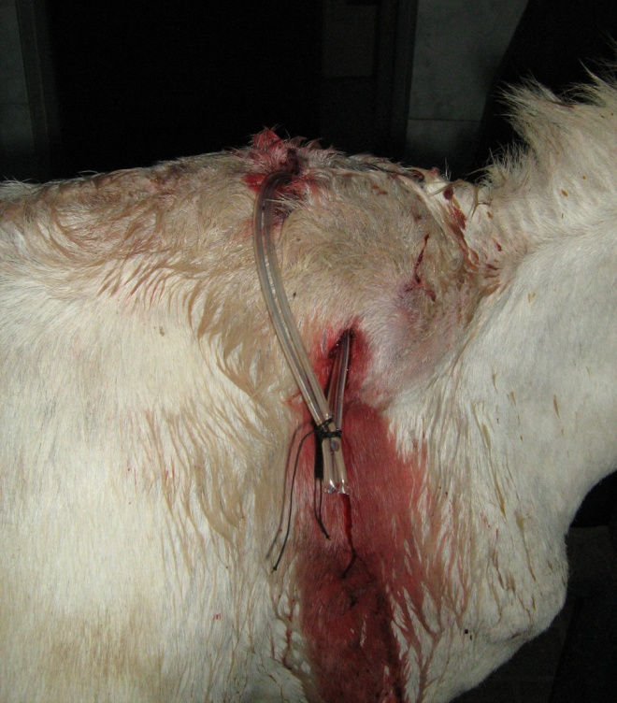
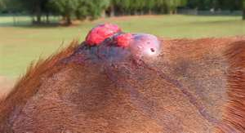
III-Fistula and sinus

Slide 18
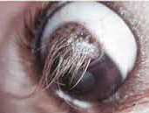
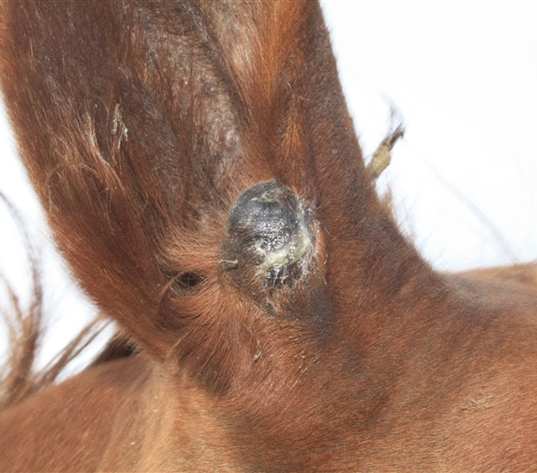
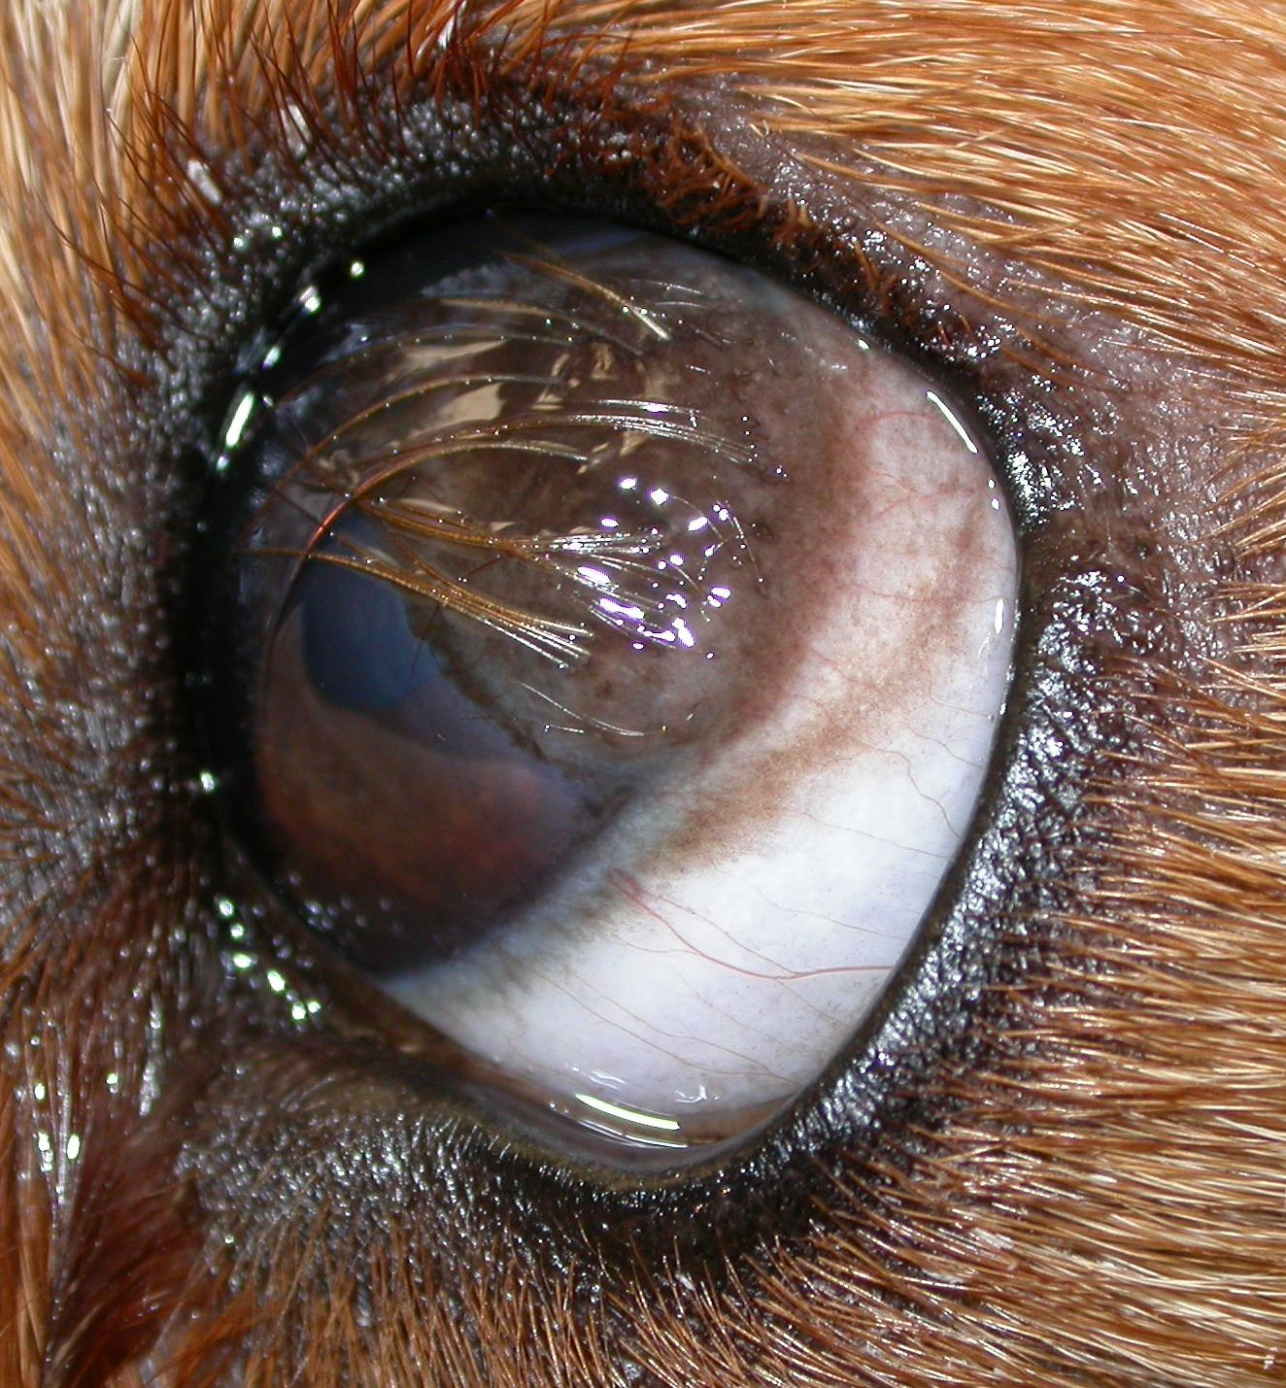
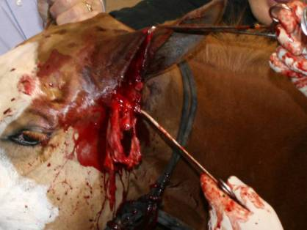

Slide 19





Classification
I-Congenital
II-Acquired
1-Dermoid cyst
A-Simple
lined with epithelium , contains mucoid,
Teratoma like, affects calves (neck, Entrance of larynx, Posterior part of lower maxilla) similar to skin (has hair follicle and sebaceous gland)
B-Compound
Bony alveoli, first molar teeth
C-Follicular
2-Dentigerous cyst

Slide 20
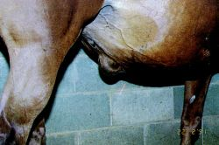

Cause Origin
I-Epithelial
1-Dermoid
2-Tongue base, pharyngeal, or epiglottis
calves and foals, has mucoid contents. pedunculated or not, large round cyst that may interfere with mastication or cause dyspnea and asphyxia
3-Umbilical
calves and foals and contains mucoid contents
4-Traumatic epithelial

Slide 21
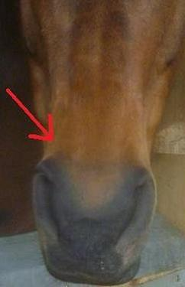
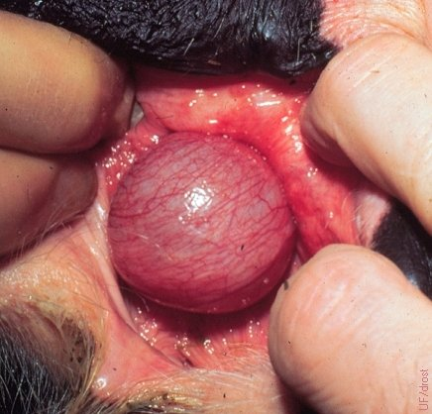

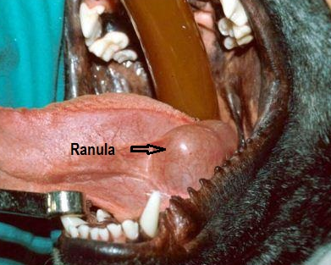
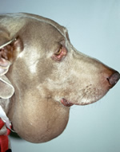

II-Retention
1-Atheroma Sb
2-Mucous membrane
3-Salivary, neck, brachial or honey cyst or ranula

Slide 22
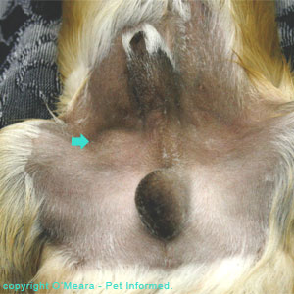
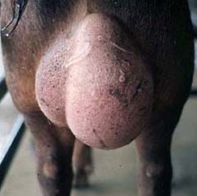
III-Exudation
C
C
C

Slide 23
IV-Parasitic
V-Degenerative

Slide 24
Symptoms
1-Non-inflammatory swelling
2-Slow growth
3-Contain fluid, semi-fluid or solid contents
4-Well defined wall without path lesion of covering skin

Slide 25


Diagnosis
1-History
2-Clinical signs
3-Clincal examination
Exp puncture
4-Diff diagnosis
5-Radiography

Slide 26
Treatment
1-Aspiration and injection of irritants
2-Incision and swap with irritants
3-Seton
4-Ecraseur
5- Surgical excision

Slide 27


3-BURSITIS
Closed sac lined with synovial membrane
Located at boney prominence or between moving parts
Permits gliding and prevents friction
Congenital, natural, true, typical or deep
Acquired, false, atypical or subcutaneous

Slide 28

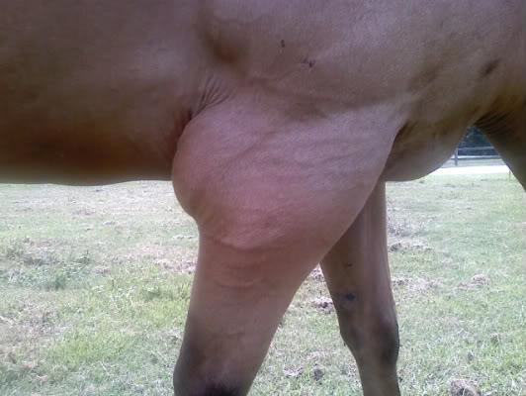
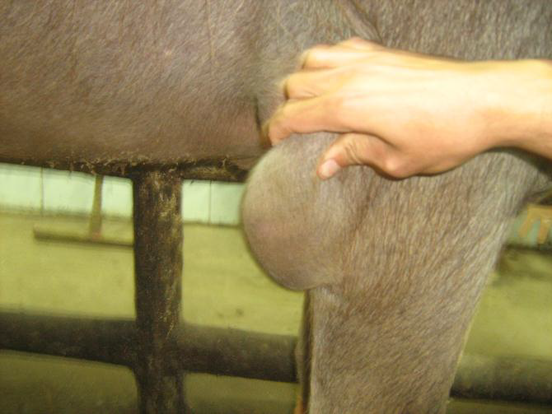
I-ACUTE BURSITIS
1-Aseptic bursitis
2-Septic bursitis
1-Dry
2- Serous

Slide 29
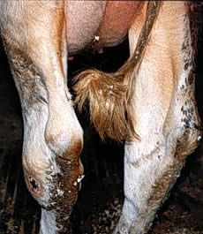

1-Aseptic bursitis
Cause
2-Septic bursitis
Trauma
Infection
Signs
Inflamed distended bursa
Pain during motion
Distention with serous form
Draining

Slide 30

1-Aseptic bursitis
Treatment
2-Septic bursitis
Remove the cause
Surgical drainage
Rest
Control of infection
Cold application
Anti-inflammatory
Local steroids and penicillin

Slide 31
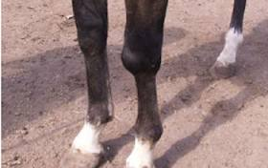
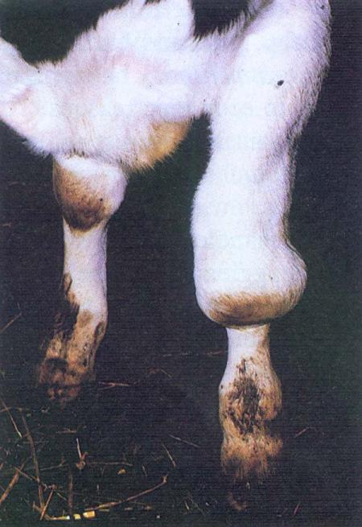
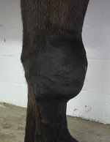
II-CHRONIC BURSITIS
Mild repeat
trauma
After
inf bursitis
1-Cystic bursitis
Cyst formation
Variable quantity fluid
May contain cartilaginous
Thick fibrous wall

Slide 32
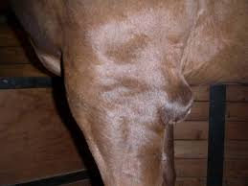
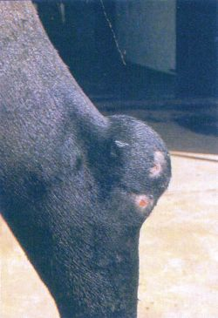

2-Proliferative bursitis
3-Fibrous bursitis
4-Hemorrhagic bursitis

Slide 33
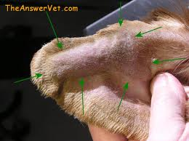
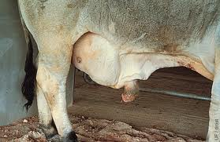
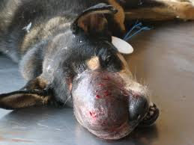
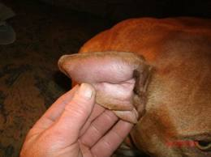
6-HEMATOMA

Slide 34
