Slide 1
puerperium

Slide 2
Definition:-
The period after calving when the genital organ are returning to their non pregnant state.
Important changes occurduring the puerperium
1-shrinkage of the uterus to its normal non pregnant state
2-regeneration of the endometrium
3-elimination of bacterial contamination
4-return to normal cyclical ovarian activity

Slide 3
the duration of puerperium
In cow :about 75 days
In small ruminant :as cow
In mare : about 9 days

Slide 4
Uterine discharge{lochia}
Definition:-
It is discharge which escape from uterus during the period of puerperium.
Composition:-
It consist of blood fibrin , parts of the placenta , fetal fluid , epithelium & mucous

Slide 5
Consitancy | odor | Color | Animals
After delivery: sticky mucoid After aweek: Thiner and mixed with flakes At the end of puerperium: Glassy mucoid | Odorless | After delivery: Brown red After aweek: Chocolate At the end of puerperium: clear | Cattle
mucoid | odorless | After birth: It is red brown then it start to change to brown,yellowish | Mare
mucoid | odorless | Blood mucoid at first then it change to be turbid | Small ruminant
mucoid | odorless | Greenish black due to presence of bile like pigment called{uterovirdin} | bitch

Slide 6
Closure of the cervical canal
The external os is closed less rapidly than internal os
On 3rd day postpartum the external cervical os can pass one hand ,while the internal os admits only 2:3 fingers
At the end of the 1st week the external os admits 1:2finger while the internal os can only pass astraw

Slide 7
Factor influencing the rate of uterine involution
-Parity : involution is likely to be more rapid in primipara than pluripara.
-Season of the year:involution is propbably quicker in spring and summer –calving cows
-Suckling: possibly hastens involution
-Climate:affect on involution
-Suckling intensity and milking frequency : the greater the frequency of milking and intensity of suckling the longer the aperiod of cyclicity

Slide 8
Pathology of puerperium
Disturbance of puerperium may result from:
-Atony of the uterus
-retention of the placenta
-Prolapse of vagina or uterus
- injury in birth way
- infection or intoxication.

Slide 9
Retention of the placenta
Primary retention of the fetal membrane result from a lack of detachment from maternal caruncle .
Whereas secondary retention is related to amechanical difficulty in expelling already detached fetal membrane

Slide 10
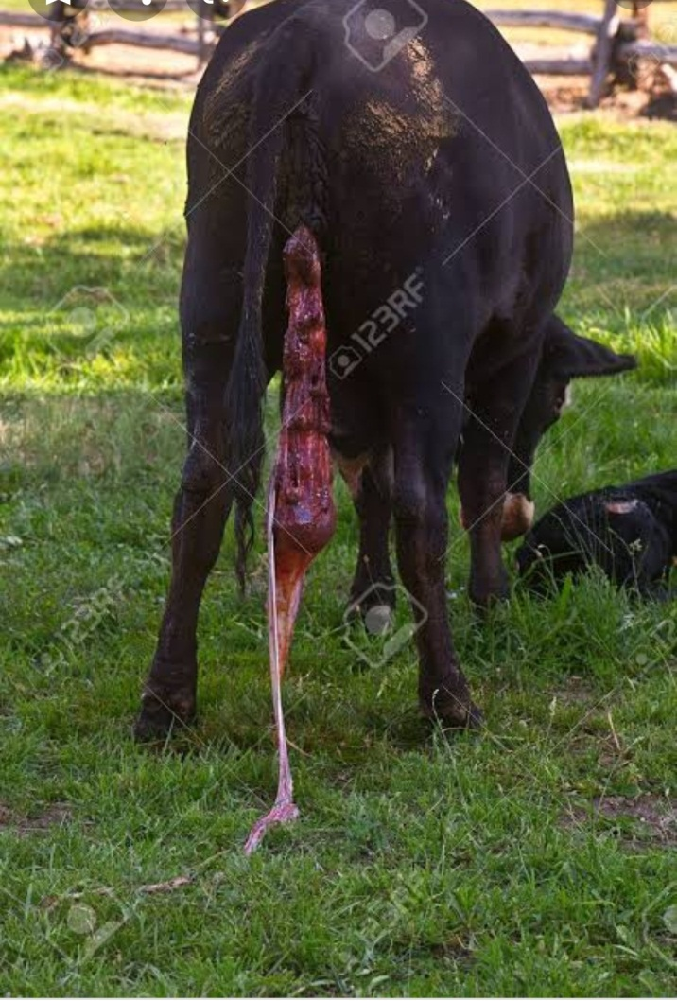

Slide 11
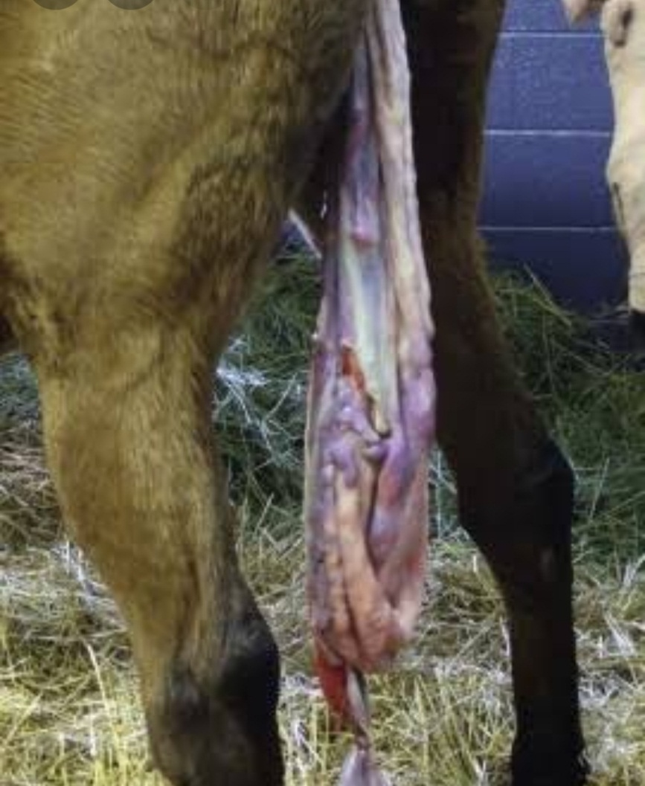

Slide 12
Causes f retention of placenta
They are classified into 2 main categories:
1- interference with normal loosening and separation process between the maternal caruncle and fetal cotyledon
a) Immature placentom
b) edema of chronic villi
c)prolonged gestation
d) hypermia of placentom
e) Necrosis of placentomes
f) Placentitis and cotyledonitis
2- uterine atony {inertia}
Hydropsy , twining , dystocia & hypocalcemia

Slide 13
Another classification of the causes
The causes are classified into : infectious , hormonal & nutritional
1- infectious causes:
a) Non specific infection
Retained placenta and metritis
Retained placenta and mastitis
Retained placenta and laminitis
Retaind placenta and hypocalcemia

Slide 14
b) Specific infections
1- bacterial causes
Brucellosis , leptospirosis
2- viral causes
IBR , BVD
3-parasitic infestation
Coccidial parasite called neospora like abortion in cattle

Slide 15
2- hormonal causes
a) E2 & P4
Higher level of the serum P4 and lower level of E2 observed in cow with retained placenta
b) prostaglandins
Cow with retained placenta has less synthesized Prostaglandin F2 alpha from their fetal cotyledon

Slide 16
3 -Nutritional causes:
Nutritinal causes of retention are due to diet feeding the last 6:8 Wks before calving
The dietery deficiency of imblance of energy , protein , iodine , vit A , D ,E are caused of retention placenta

Slide 17
Treatment of retained placenta
1- manual remove
2-manual remove with antibiotics
Oxytetracycline
Sulphonamide
Lugol solution
3- theraputic treatment using stimulants without manual remove
Oxytocin , E2 , prostaglandine , ergot derivative &Ca preparation

Slide 18
Prevention and control of retained placenta
1- proper feeding program duringg the dry period
VIT E & Se
Inject 50 mg of Se to buffalo in last month of pregnancy reduce the incidence of retained placenta
2-Hyginic procedure at the time of birth
3-Minimize stressful condition
4-Maintain vaccination program against infectious causes

Slide 19
Secondary retention of the placenta in mare
It occurs very seldom in the mare , it mostly occurs after abortion in 6:9 Mo
Causes :
It is caused by acute placentitis
The bacterial infection during pregnancy doesnot result in retention of the placenta but looseness of allanto chorion because the tuft is very fine resulting in abortion

Slide 20
Symotoms:
It is considered as acase of secondary retention of the placenta after 2 hour
The mare is restless and strains too much.

Slide 21
therapy
The removal of placenta is done by
-Very nice washing of the outer genitalia with water and soap
-take hold of protruding placenta out of the vulva with left hand
-introduce the right hand between placenta and the wall of the uterus seperating the fetal membrane from the endometrium

Slide 22
-remove the whole placenta at one time and donot leave any part of it
-wash the uterus with awarm solution of mild antiseptic as betadine
-put full dose of antibiotic ttt in uterus
-Give dose of anti tetanic serum as prophylaxis
-treatment symptomatically any other symptom

