Slide 1

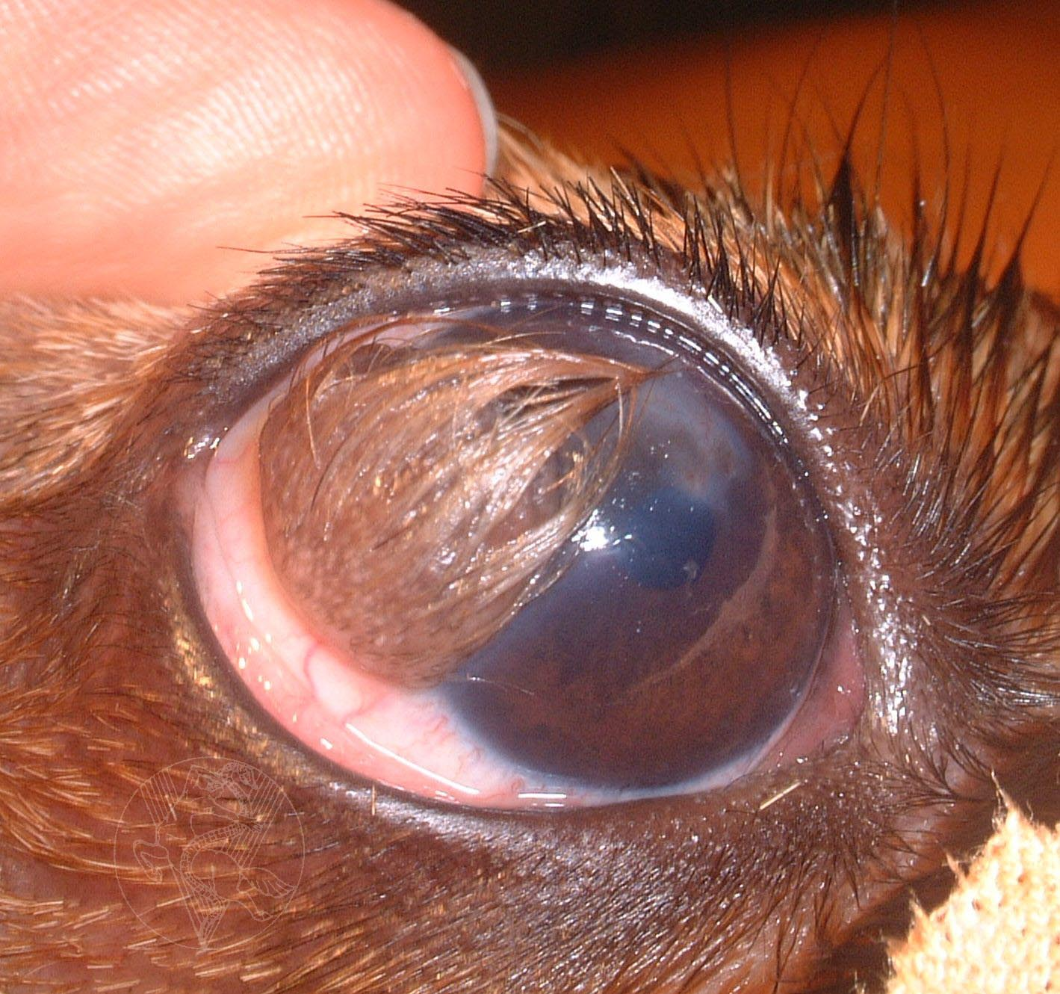
5-AFFECIONS OF THE CONJUNCTIVA
I-Congenital
1-DERMOIDS
2-ECTOPIC CILIA
Signs
1-Epiphora, blepharospasm & mucoid dis
2-Cilia

Slide 2
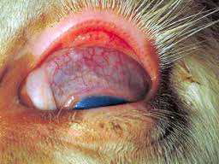
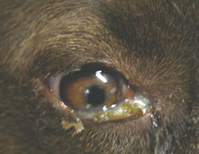
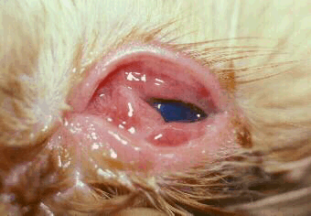
II-Acquired diseases
1-CONJUNCTIVITIS
Signs
1-Active hyperaemia
2-Chemosis
3-Ocular discharge
4-Follicles
5-Pain
Causes

Slide 3
CLASSIFICATION
A-Catarrhal Conjunctivitis
Signs
1-Active hyperaemia
2-Chemosis
3-Ocular discharge
4-Pain
5-Eyelids Inf + Swelling
Treatment
Cause-wash
Antibiotics
Corticosteroids
Antihistaminics

Slide 4
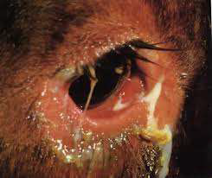
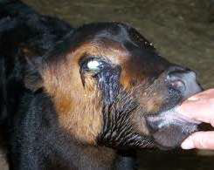
B-Purulent Conjunctivitis
Signs
1-Active hyperaemia
2-Chemosis
3-Ocular discharge ***
4-Eyelids infl + edema+ stick
Treatment
Cause-wash
Antibiotics
Corticosteroids

Slide 5
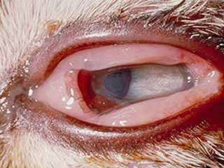
C-Parenchymatous Conjunctivitis
Signs
1-Chemosis
2-Ocular discharge
Treatment
Worm compression
Antibiotics
Corticosteroids
Antihistaminics

Slide 6
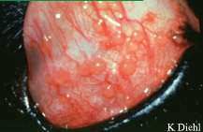
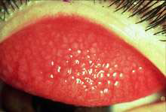
D-Follicular Conjunctivitis
Signs
grayish mucoid discharge
hypertrophied lymphoid follicles
Treatment
Antibiotics
Cause
Corticosteroids
Eye
Remove follicles
Curret
Nictita
Cuppor silver

Slide 7

E-Ophthalmia Neonatorium
Signs
purulent discharge builds up beneath lids causing them to swell and may extrude at the medial canthus
Treatment
1-Seperate the lids
2-Wash the eyeball
3-Apply broad-spectrum antibiotics

Slide 8
2-CONJUNCTIVAL WOUNDS
heal quickly and sutured only if extensive
heal without surgical interferences
Removing any protruding peri-orbital fat through the wound before suturing.

Slide 9
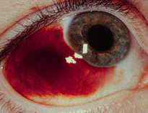
3-SUB-CONJUNCTIVAL HEMORRHAGE
Treatment
1-Apply epinephrine 1-2% topically
2-Subconjunctival corticosteroids

Slide 10
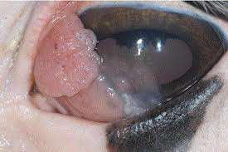
4-CONJUNCTIVAL TUMORS

Slide 11
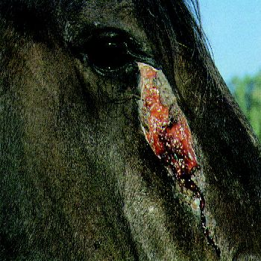
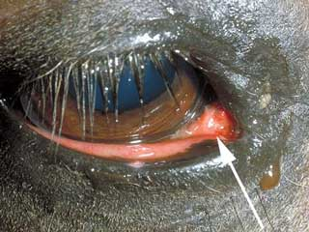
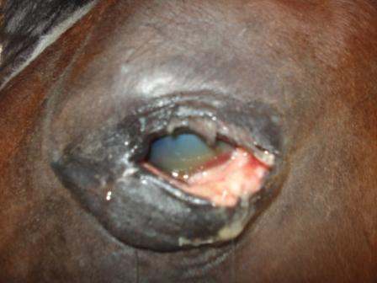
5-HABRONEMIASIS OF THE CONJUNCTIVA

Slide 12

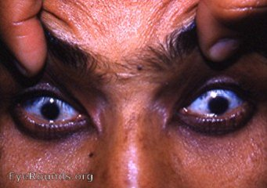
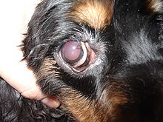
7-AFFECIONS OF THE CORNEAC
I-Congenital
1-MICROCORNEA
2-MACROCORNEA (Megalocornea)

Slide 13
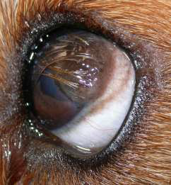
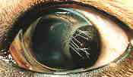
3-DERMOIDS
4-COLOBOMA OF THE CORNEA

Slide 14
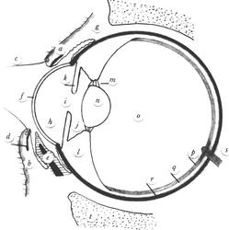
II-Acquired diseases
1-KERATITIS
A-Subjective Symptoms (general signs)
Pain (photophobia and blepharospasm)
Epiphora

Slide 15
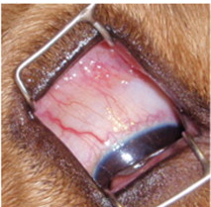
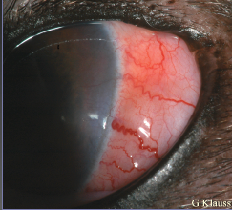
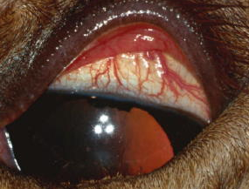
B-Objective Symptoms (specific signs)
1-Injection of conjunctival and ciliary blood vessel
Bright red dilated,
Tortuous
Movable
Darker,
Straighter,
Non-movable

Slide 16
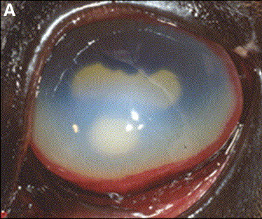
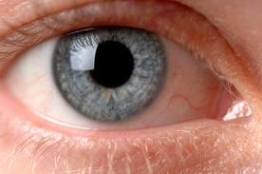
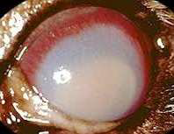
2-Loss of corneal transparency
Corneal edema
or
Leucocytic infiltration

Slide 17
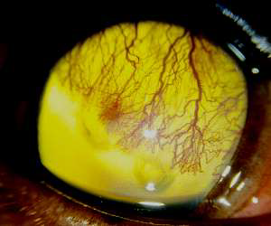
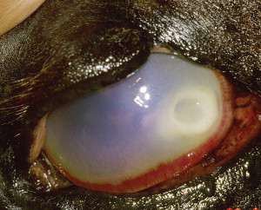
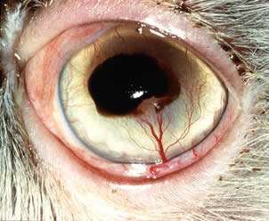
3-Vascularization of the cornea
Superficial
Deep

Slide 18
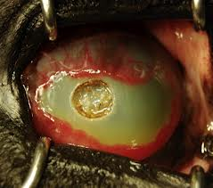
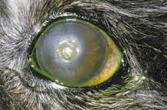
4-Ulceration of the cornea

Slide 19
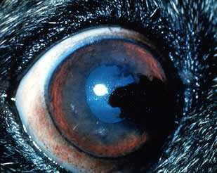
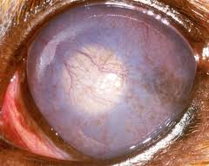
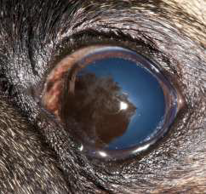
5-Pigmentation of the cornea

Slide 20
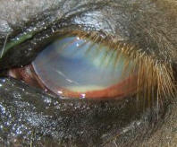
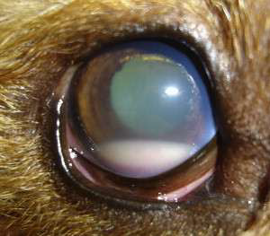
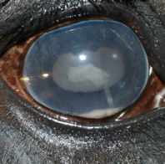
6-Hypopyon

Slide 21
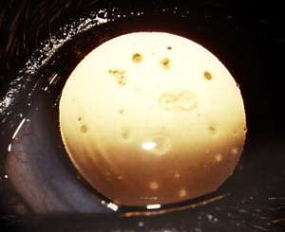
Classification
A-Superficial Keratitis
1-Superficial Punctate Keratitis
It is unilateral or bilateral, randomly positioned, epithelial and subepithelial, tiny white opacities
Usually, there are no clinical signs or ocular inflammations
Treatment
Topical Cortic, AB and/or yellow mercuric oxide

Slide 22
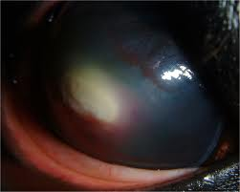
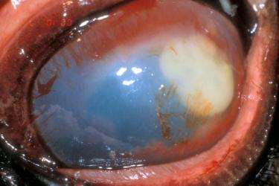
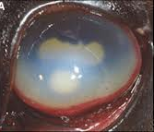
2-Superficial Corneal Abscess
Green yellowish swelling of the cornea (few millimeters)
Treatment
Incision or superficial keratectomy

Slide 23
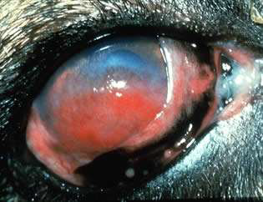
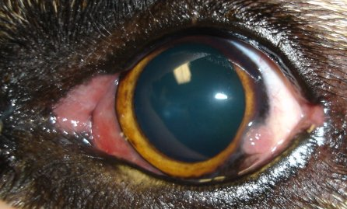
3-Pannus - Uberreiter's Syndrome (degener pannus)
-Unknown cause bilateral diffuse keratitis of superficial corneal layers with sub-epithelial CT infiltration and corneal neo-vascularization
-Chronic, progressive and cannot be cured
1-Grayish haze ---- temporal limbus----nasal limbus-----cover cornea
2-Superf vascularization (conjunctiva)
3-Pigmentation over the cornea
4-It ends with blindness

Slide 24
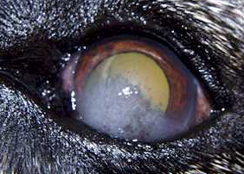
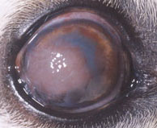
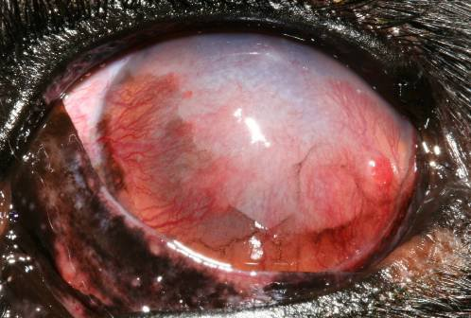
Treatment
1-Early cases ,,,,,,,,,,, Top Cortico
2-Moderately advanced,,, SC Cortic
3-Advanced cases & minimal scarring Beta
4-Chemical cauterization (phenol)
5-Superficial keratectomy (Adv + scarring)
6-Periotomy

Slide 25
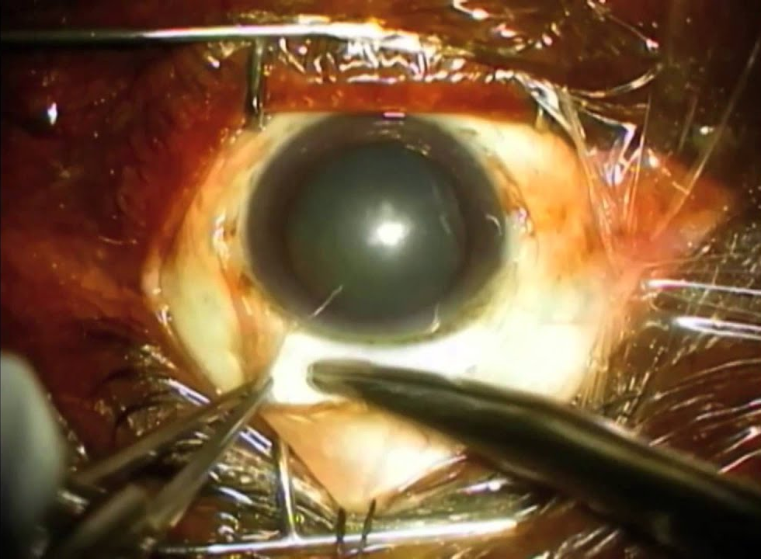
6-Peritomy
4-Kerato-conjunctivitis Sicca

Slide 26
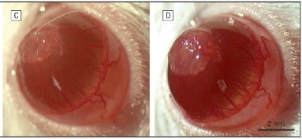
5-Exuberant Granulation Tissue
On the surface of the cornea as a result of injury
Superficial vascularization observed crossing the cornea to the area of granulation
1-Peritomy
2-Surgical removal of the granulation tissue
Treatment

Slide 27
B-Pigmentary Keratitis
Treatment
1-Remove the cause
2-Superficial lamellar keratectomy
3-Tattooing

Slide 28
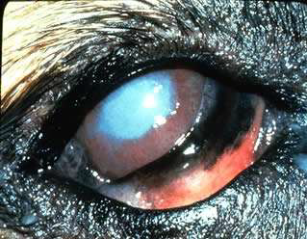
C-Interstitial or Deep Keratitis

Slide 29
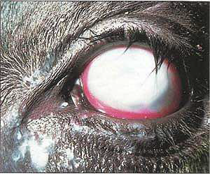
Signs
1-Corneal opacity
3-Conjunctival and ciliary injection
2-Deep vascularization
4-Hypopyon may be present
Treatment
1-A B
2-Ant Infl
3-Atropine

Slide 30
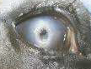
D-Ulcerative Keratitis or Corneal Ulcer

Slide 31
Causes
Signs
1-Severe pain (btepharospasm and photophobia)
2-Mucopurulent - purulent discharge
3-Loss of corneal transparency
(corneal opacity)
4-Vascularization
5-The presence of the ulcer
Diagnosis

Slide 32
Treatment
1-Remove the cause
2-AB
3-Atropine
4-Anti Infl *********
5-Cautarization
6-Flap
7-Keratectomy

Slide 33





FATE
A-Scar Formation

Slide 34



B-Descemetocele (Keratocele)

Slide 35



C-Iris Prolapse
D-Iris Staphyloma

Slide 36

E-Hypopyon

Slide 37





F-Anterior or Posterior Synechiae
G-Panophthalmitis

Slide 38

CONJUNCTIVAL FLAPS
A-Partial or Hood Bulbar Conjunctival Flap

Slide 39

B-Complete Bulbar Conjunctival Flap (double hood conjunctival flap)

Slide 40


C-Central Bridge Conjunctival Flap

Slide 41


D-Pedicle or Rotational Conjunctival Graft

Slide 42

THIRD EYELID FLAP

Slide 43
2-Lipid Corneal Degeneration or Lipid Keratopathy
3-Corneal Wounds
A-Superficial Wounds
usually heal within 24-48 hours without treatment
corneal suturing is indicated supported and by third eyelid flap
B-Deep Wounds
Small punctured wound without iris prolapse -- suturing wound + third eyelid flap.
iris prolapse, replace iris in (recent) or amputate (old) + suture cornea +third eyelid flap.
C-Perforating Corneal Wounds

