Slide 1
Protein Metabolism
Dr. Ahmed Elsaid Osman

Slide 2
Protein metabolism
Protein metabolism denotes the various biochemical processes responsible for the synthesis of proteins and amino acids (anabolism), and the breakdown of proteins by catabolism.
What is protein?
Protein is one of the most important substances in your body. Your muscles, hair, eyes, organs, and many hormones and enzymes are primarily made out of protein. It also helps to repair and maintain your body tissues.

Slide 3
Protein is a very large nutrient that’s made up of smaller substances called amino acids. There are 20 amino acids, but your body can only make 9 of them. The other 11 are called essential amino acids, and you can only get them through your diet.
Digestion of protein
Digestion is the breakdown of large insoluble food molecules into small water-soluble food molecules so that they can be absorbed into the watery blood plasma.

Slide 4
Protein digestion occurs in the stomach and duodenum in which 3 main enzymes, pepsin secreted by the stomach and trypsin and chymotrypsin secreted by the pancreas, break down food proteins into polypeptides that are then broken down by various exopeptidases and dipeptidases into amino acids.

Slide 5
How is protein absorbed?
Protein absorption happens in small intestine, which contains microvilli. These are small, finger-like structures that increase the absorptive surface area of your small intestine. This allows for maximum absorption of amino acids and other nutrients.
Once they’ve been absorbed, amino acids are released into your bloodstream, which takes them to cells in other parts of your body so they can start repairing tissue and building muscle.

Slide 6
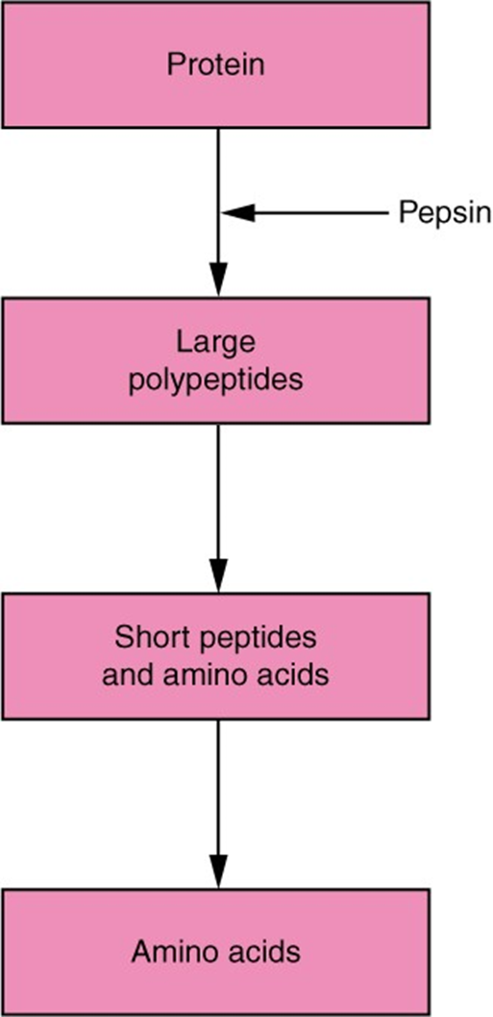

Slide 7
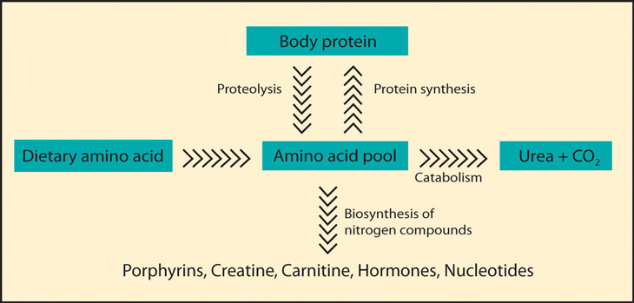

Slide 8
Catabolism of amino acids
The liver is the principal site of amino acid metabolism, but other tissues, such as the kidney, the small intestine, muscles, and adipose tissue, take part.
The first step of catabolism involves the removal of the &-amino groups usually by transamination and subsequent oxidative deamination forming ammonia and the corresponding &-keto acid .
Removal of Nitrogen from Amino Acids
The dominant reactions involved in removing amino acid nitrogen from the body are known as transaminations ,This class of reactions funnels nitrogen from all free amino acids into a small number of compounds; then, either they are oxidatively deaminated, producing ammonia, or their amine groups are converted to urea by the urea cycle.

Slide 9
Transamination
Transamination is an exchange of functional groups between any amino acid (except lysine, proline, and threonine) and an α-keto acid.
Amin oacid + α-ketoglutarate ↔ α-keto acid + Glutamate
The amino group is usually transferred to the keto carbon atom of pyruvate, oxaloacetate, or α-ketoglutarate, converting the α-keto acid to alanine, aspartate, or glutamate, respectively.
Transamination is mediated by several different aminotransferase enzymewhich require pyridoxal phosphate as a coenzymes . These may be specific for individual amino acids, or they may be able to process a group of chemically similar ones.

Slide 10
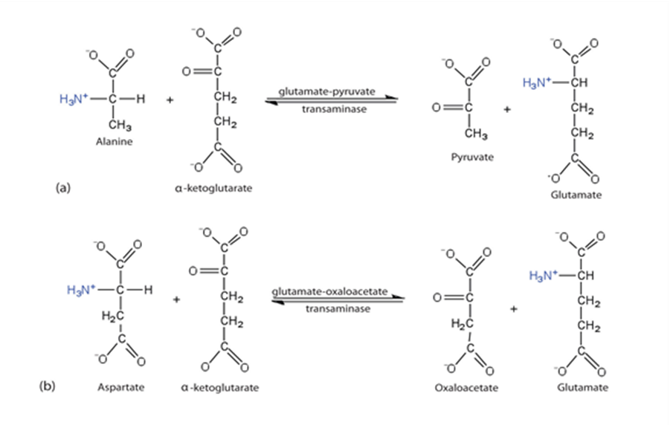
The two common types of aminotransferases are Alanine aminotransferase (ALT) and Aspartate aminotransferase (AST).

Slide 11
Clinical Significance
The two serum transaminases currently of clinical import are serum glutamic-oxaloacetic transaminase (SGO-T) and serum glutamic-pyruvic transaminase (SGP-T). Both serum enzymes have been measured chromatographically, spectrophotometrically, and colorimetrically.
Significant alterations of these serum enzymes have been observed during the course of cardiac, hepatic, and muscular diseases, and reflected enzyme changes at the intracellular level of the respective tissues. Although a multiplicity of diseases is associated with serum transaminase elevations, diagnostic aid is afforded when these serum enzyme alterations are correlated with the clinical facts.

Slide 12
Cholestatic lesions associated with either intrahepatic or posthepatic diseases are manifested by modest transaminase elevations, with AST usually exceeding ALT.
Measurement of serum ALT activity is routinely used to screen blood donors at risk of transmitting hepatitis, particularly the non-A, non-B type, since no specific serologic test is available. Use of ALT as a surrogate test for non-A non-B hepatitis expectedly reduces the incidence of post-transfusion hepatitis by 29%.

Slide 13
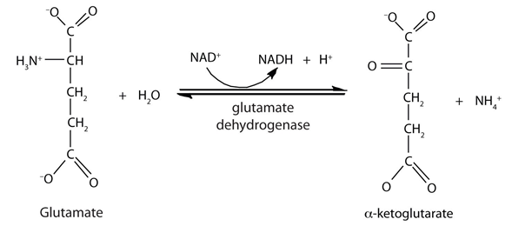

Slide 15
Ammonia
Ammonia production occurs in all tissues of the body during the metabolism of a variety of compounds. Ammonia is produced by the metabolism of amino acids and other compounds which contain nitrogen.
Ammonia exists as ammonium ion (NH4+) at the physiological pH and is produced in our body mainly by the process of transamination followed by deamination, from biogenic amines, from amino groups of nitrogenous base like purine and pyrimidine and in the intestine by intestinal bacterial flora through the action of urease on urea

Slide 16
Ammonia disposal takes place primarily by the hepatic formation of urea.
The blood level of ammonia must remain very low because even slightly elevated concentrations (hyperammonemia) are toxic to the central nervous system (CNS).
A metabolic mechanism exists by which nitrogen is moved from peripheral tissues to the liver for its ultimate disposal as urea, while at the same time maintaining low levels of circulating ammonia.

Slide 17
The amino acids take part in certain common reactions like transamination followed by deamination for production of ammonia.
The amino group of amino acids is utilized for formation of urea which is an excretory product for protein metabolism. The amino acid is transaminated to produce a molecule of glutamate.
Glutamate is the one amino acid that undergoes oxidative deamination to liberate free ammonia for the synthesis of urea.
.

Slide 18
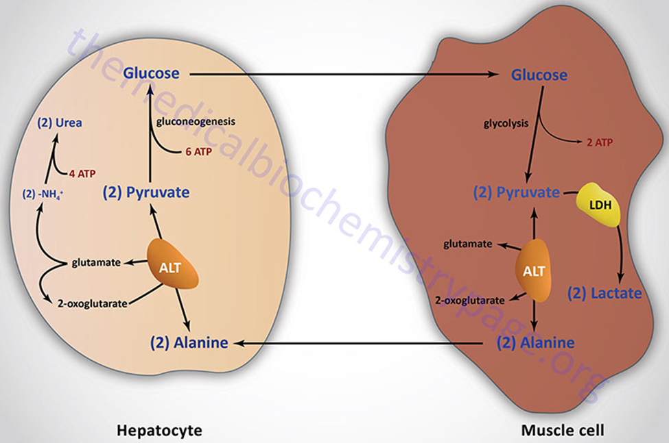
Once free ammonia is formed in peripheral tissues, it must be transferred to the liver for the conversation to urea. This is carried out by the ‘glucose-alanine cycle”. In the glucose-alanine cycle, alanine which is formed by the transamination of pyruvate gets transported in the blood to the liver, where it is transaminated by alanine transaminase to pyruvate.

Slide 19
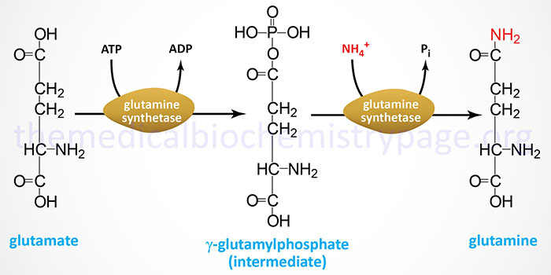
The non-toxic storage and transport form of ammonia in the liver is glutamine. Ammonia is loaded via glutamine synthetase by the reaction, NH3 + glutamate → glutamine. It occurs in nearly all tissues of the body. Ammonia is unloaded via glutaminase by a reaction, glutamine --> NH3 + glutamate. It specifically occurs in kidneys and intestine and in very low concentration in the liver. This reaction is induced by acidosis.

Slide 20
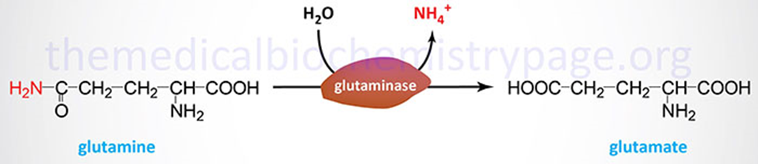
The glutamine synthetase reaction is also important in several respects. First it produces glutamine, one of the 20 major amino acids. Second, in animals, glutamine is the major amino acid found in the circulatory system. Its role there is to carry ammonia to and from various tissues but principally from peripheral tissues to the kidney, where the amide nitrogen is hydrolyzed by the enzyme glutaminase (reaction below); this process regenerates glutamate and free ammonium ion, which is excreted in the urine.

Slide 21
.
Urea cycle (Ammonia detoxification)
The urea cycle (also known as the ornithine cycle or the Krebs-Henseleit Cycle ) is a cycle of biochemical reactions that produces urea (NH2)2CO from ammonia (NH3).
This cycle occurs in ureotelic organisms. The urea cycle converts highly toxic ammonia to urea for excretion
Ammonia is rapidly removed from the circulation in the liver, converted into a water soluble compound known as urea.

Slide 23
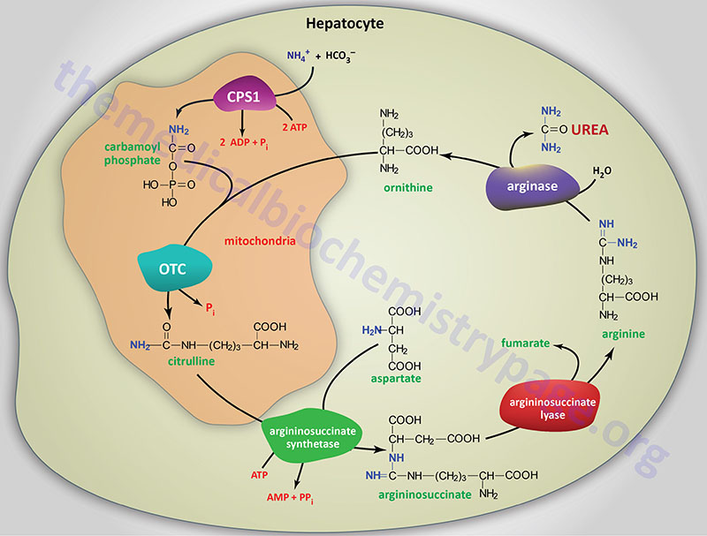

Slide 24
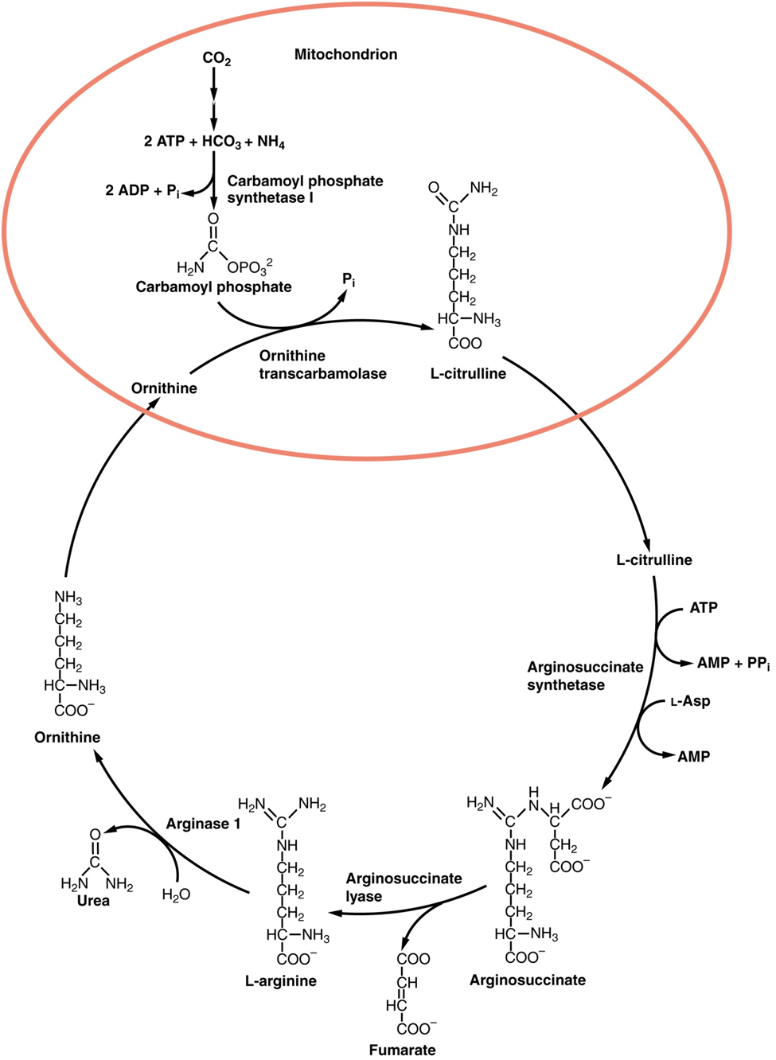

Slide 25
Regulation
N-Acetylglutamic acid
The synthesis of carbamoyl phosphate and the urea cycle are dependent on the presence of N-acetylglutamic acid (NAcGlu), which allosterically activates CPS1. NAcGlu is an obligate activator of carbamoyl phosphate synthetase.[4] Synthesis of NAcGlu by N-acetylglutamate synthase (NAGS) is stimulated by both Arg, allosteric stimulator of NAGS, and Glu, a product in the transamination reactions and one of NAGS's substrates, both of which are elevated when free amino acids are elevated. So Glu not only is a substrate for NAGS but also serves as an activator for the urea cycle.
Substrate concentrations
The remaining enzymes of the cycle are controlled by the concentrations of their substrates. Thus, inherited deficiencies in cycle enzymes other than ARG1 do not result in significant decreases in urea production (if any cycle enzyme is entirely missing, death occurs shortly after birth). Rather, the deficient enzyme's substrate builds up, increasing the rate of the deficient reaction to normal.

