Slide 1

Chemical analytical constants
Iodine value (number):
Definition:
is the number of grams of iodine absorbed by the unsaturated F .A. in 100 g fat or oil.

Slide 2
Therefore, more saturated F.A. less iodine is required.
Therefore, as the degree of unsaturation increase iodine number the biological value of the fat increase.
Aim :
Identification the type of fat and oil.
Detection of adulteration of fat and oil.
Determine the biological value of fat .

Slide 3
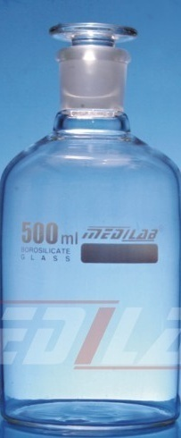
Procedures:
In tow clean and dry white glass add:
test bottle(A) blank bottle(B)
Fat or oil 0.5 g ------
Chloroform 10 ml 10 ml
Standard iodine sol. 25 ml 25 ml
The 2 bottle are shaked well to complete mixing

Slide 4
Then kept 2 glasses in dark place for 30 min. with periodical shaking.
Add in both bottle (A) (B)
Potassium iodide sol.15% 10ml 10ml
Water (boiled and cooled) 50ml 50ml
The contents are mixed will.
Titrate in tow bottles with standard N/10 sod. Thiosulphate sol. until the end point (faint yellow color).

Slide 5

Add for both bottle 1ml soluble starch 1%
developing of blue color.
Continue titration untill disappearance of blue color.
Record the amount of N/10 sodium thiosulphate used in bottle A & B.
calculation:
1ml N/10 sod. Thiosulphate neutralize 0.01269 g iodine

Slide 6
A is the number of ml of sod. Thiosulphate
sol. Used for titration of the test portion.
B is the number of ml of sod. Thiosulphate
sol. Used for titration of the blank portion.
Different I.V. values
Iodine value | Fat or oil
32 - 40 | Butter fat
60 - 80 | Hydrogenated cotton seed oil
101 - 115 | Cotton seed oil
101 - 115 | Seasam oil

Slide 7
Reichert –Meissel and Polenske value
They measure the amount of volatile F.A. which can recover from fat under standard condition.
Water soluble F.A. : butyric - caproic
water insoluble F.A. : caprylic – lauric
Significance :
Detection of butter adulteration with margarine or other foreign fats

Slide 8
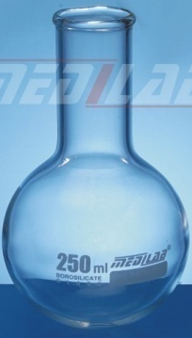

Richert – Meissel (soluble volatile F.A.)
Definition:
is the number of ml of 0.1 N NaoH sol. required to neutralize the water soluble volatile F.A. distilled from 5gm of fat or oil.
Procedure:
Saponification of the sample
- in a clean and dry flask add
5 gm sample
20 ml glycerol soda sol.

Slide 9

Heat over a flame until complete saponification
the mixture become clear
Distillation:
- add 135ml of freshly boiled and cooled water drop by drop at first to prevent foaming.
- add 6ml sulphuric acid 20%
+ few pumic stones
- distillate the F.A. using special apparatus until collect 110ml of distillate in a volumetric flask.

Slide 10
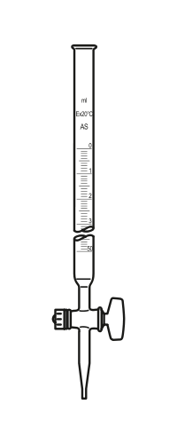
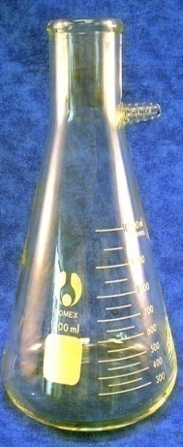
Filtration:
Filtrate to separate between water-soluble in filtrate and water insoluble in the filter paper.
Titration:
in a flask add:
100ml of the filterate
+ 1ml ph ph sol. as indicator
Titrate with N/10 NaoH until
obtain faint pink color

Slide 11
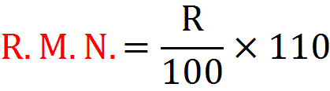
Caculation:
R = number of ml of N/10 NaoH used in
titration

Slide 12
Polenske number (insoluble volatile F.A. value)
Definition: is the number of ml of N/10 NaoH sol. required to neutralize the water insoluble F.A. distilled from 5gm of fat or oil.
Procedure:
Remove the remainder of the soluble acids from the insoluble acids upon the filter paper by washing with 3 successive 15ml portions water.
Then washed by 15ml neutral alcohol for 3 times.
Titrate the filtrate (alcohol soluble F. A.) against N/10 NaoH with 1ml ph ph as indicator.

Slide 13

Calculation:
R = number of ml of alkaline used in titration.
coconut oil | Animal fat | Butter | Constant
6 - 8 | Less than one | 24-30 | R.M.N.
16 - 18 | Less than one | 2 - 3 | P.N.

Slide 14
N.B : as the butter fat contain the highest amount of water soluble F.A., the R.M. value is high and adulteration by any type of fat lower the R.M. value of butter.
EX. Adulteration with coconut oil will decrease the R.M. of butter fat as coconut oil fat has lower value but P.V. of butter fat will increase as coconut oil has high P.V.

Slide 15
Specific tests
Baudouin’s test
is used for detection of
Procedure:
In a test tube add
5ml of the oil
2.5 ml of conc. Hcl containing 1% sucrose (freshly prepared)
Shake well & stand for 5 -10 min
developing of crimson color
for sesame oil.
Aim:
sesame oil
+ve
Result:

Slide 16
N.B.
The crimson color is due to sesame oil which contains phenolic substance, sesamin & sesamoline which are not removed by refining the oil, and give the color when shake with Hcl containing sucrose.
0.1% of sesame oil can be detected by
Baudouin’s test.
This test can detect butter adulteration
with margarine as margarine must be
contain 5%
sesame oil.

Slide 17
Halphen’s test
is used for detection of cotton seed oil.
In a clean test tube add
5ml of oil sample
5ml amyl alcohol
5ml 1% sulphur in carbon bisulphide
Some powdered pumice (to prevent pumping)
Tightly sealed the test tube and heat for 30 min in a boiling water bath.
Aim:
Procedure:

Slide 18
Result:
Deep red color (crimson color)
for cotton seed oil.
N.B.
0.1% of cotton seed oil can be detected
by Halphen’s test.
+ve

Slide 19
Nitric acid test
for detection adulteration of olive oil with foreign oil.
In a clean test tube add
5ml oil sample
5ml nitric acid (9:1)
Shake thoroughly for 2 min & allow to stand.
unchanged
brown color
Aim:
Procedure:
Result:
Pure olive oil
Indicate presence of foreign oil

Slide 20
Kreis test
for detection of rancidity.
In a test tube add
5ml melted fat or oil
5ml conc. Hcl
Stopper the tube with rubber stopper & shake vigorously for 30 sec
Add 5ml of 0.1 % ether sol. of phloroglucinol
Aim:
Procedure:

Slide 21
Restopper and shake for 30 sec and allow to stand for 10 min
No reaction
If the pink color developed in acid layer
proceed as follow:
Dilute the original sample using petroleum ether or kerosene in a ratio 1 : 9 and 1 : 19 .
Result
no rancidity

Slide 22
Test 5ml of mixtures as above & note the
color.
Pink color
Original sample diluted
with kerosene
1 : 9
Red color
indicate rancidity but not detected by smell or taste
1 : 19
Red color
indicate definite rancidity

Slide 23
the fat or oil may then be grouped into 4 classes:
No reaction no rancidity.
Positive reaction in undiluted sample only no rancidity as far as taste and odor are concerned but will soon turned rancid.
Positive reaction in dilution 1 : 9 and undiluted sample only rancidity but not detected by odor and taste.
Positive reaction in dilution 1 : 19 & 1 : 9 and undiluted sample rancidity detected by odor and taste (definite rancidity).

Slide 24


