Slide 1

Edible fats
and
oils

Slide 2
Fats and oils are mixture of triglycerides and they
occur widely in food of both animal & vegetable origin.
Most of solid fats are of animal origin while most of
liquid fats (oils) are of vegetable origin.
Exception: coconut oil solid at ordinary temperature
Fish fat liquid at ordinary temperature
Milk, cream, butter, ghee, cheese &and other dairy products.
Eggs and their products.
Meat, poultry, fish and their products.
Cereals & vegetables.
Sources of fats and oils in the diet

Slide 3
Function and uses of fats and oils in
Sources of energy:
1gm fats & oils give 37.7 K.J
protein give 23.4 K.J
CHO give 17.6 K.J
Sources of fat soluble vitamins : A, D, E, K
Sources of essential fatty acids: linoleic, linolenic, archidonic.
Formation of adipose tissues in human and animal bodies.
Make food more palatable.
Use in manufacture of margarine.
Use in manufacture of soap & glycerol.

Slide 4
Composition of fats & oils
Consists of triglycerides which may be the same or
different
-Also contain small amount of free Fatty acids and unsaponifible matters (hydrocarbons, dissolved impurities and coloring matters).
1 molecule glycerol + 3 molecule F.As Triglycerides
(fats, oil) + H₂O

Slide 5
Difference between fats and oils
Fat | Oils
solid at room temperature (except fish fat) Have higher melting point Mainly of animal origin Contain large amount of saturated F.As | Liquid at room temperature (except coconut oil) Have lower melting point Mainly of vegetable origin Contain large amount of unsaturated F.As

Slide 6
Fatty acid
Unsaturated F.A
Mono unsaturated
Poly unsaturated
Saturated F.A
e.g. Butyric, palmitic, stearic
e.g. oleic
e.g. Linoleic & linolenic

Slide 7
Diet which contain high proportion of saturated F.As may contribute to accumulate of high amount of cholesterol in blood of some people ^{lead to} disease of heart & blood vessels
Blood cholesterol levels lowered when diet contain high proportions of poly unsaturated F.As which present mainly in oils (sunflower, coconut oil).

Slide 8
Properties of fats and oils
In pure state, fat and oil have no odor, color and taste.
Fats and oils are insoluble in water ( a mixture of fat or oil and emulsifying agent form emulsion)
Fats and oils dissolved in organic fat solvent (e.g. chloroform, carbon tetrachloride, kerosene)
Fats and oils have a lower specific gravity than water.
Saponification
react with alkali forming soap + glycerol
Rancidity : all types كما سبق

Slide 9
Types of fats and oils
Crude fat & oil:
it is the fat and oil obtained from oily seeds or animal tissue in its natural state.
-they are completely untreated.
Refined fat& oil (Natural):
they are the crude fat & oil after refining process (e.g. deodorizing and decolorization).
Processed fat & oil (modified):
in which the fat & oil are different than original material by chemical treatment as hydrogenation of oil.

Slide 10
Margarine
Margarine is made by emulsifying skim milk into a mixture of purified hydrogenated oils and fats from plants or animals with addition of :
Ingredients:
Skim milk (ripened by the starter of butter) to give the desired butter flavor to the margarine.
Fats and oils : must be hydrogenated before used in margarine manufacture, not less than 80%.
Salts

Slide 11
Vitamins : A & D
Preservatives
Antioxidants
Flavoring agents
Coloring matters
Indicator additives: in order to make it easy to check for the presence of margarine in butter.
Starch
Sesame oil: not more than 5% detected by Baudouinꞌs test

Slide 12

Analysis of fats and oils

Slide 13
Object of analysis:
To determine :
type of fats and oils.
the purity of fats and oils.
the adulteration of fats and oils.
the rancidity of fat and oils.
To assess the quality of fats and oils and characteristics of fat.

Slide 14
Sampling of fat and oils
Liquid oil:
bulk: thorough mixing and taking the
required amount in clean and dry bottle.
Bottles: take one or more randomly.
Solid fat:
Large blocks: take sample from 3 different
parts and put in clean and dry jar.
Small blocks: take one or more randomly.

Slide 15
Preparation of samples
Liquid sample: thorough mixing & filtrate
if there is sediments.
Solid sample: melt the sample by heating
to 10˚c above the melting point &
filtrate if there is sediments.

Slide 16
Definition:
analytical constants are physical and chemical tests, which give characteristic values (for different fats and oils) not changed unless fats and oils are adulterated.
Analytical constants

Slide 17
Physical constants
Specific gravity
Refractive index
Melting point
Chemical constants
Specific tests
Iodine value
Saponifacation value
Reichert – Meissel and polenske values
Free fatty acid or acid value
Baudouin’s test
Halphen’s test
Nitric acid test
Kreis test

Slide 18
Physical constants
Specific gravity
Specific gravity of melted fat or oil is
determined by Westephal balance at 15.5 ᵒC
If it is determined at a higher temp. than
15.5 ᵒC the result should be corrected by the
formula:
Sp.gr. at 15.5 ᵒC = K x Spt.
Spt. = specific gravity at ordinary temp.
K = Factor at ordinary temp.

Slide 19
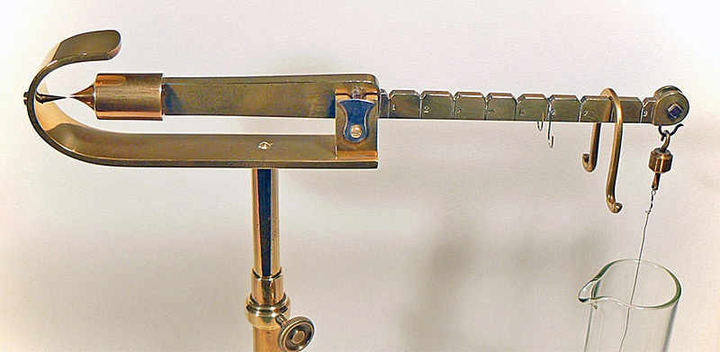
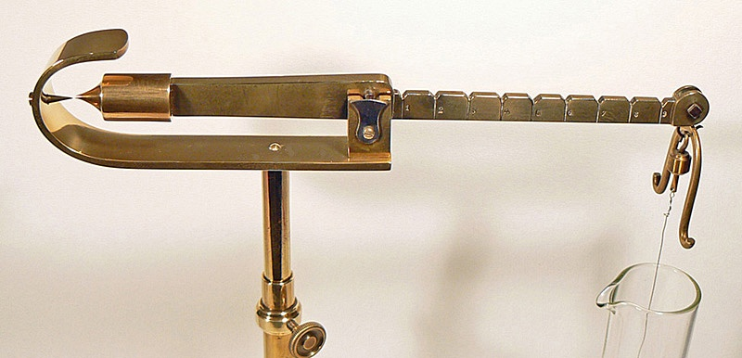
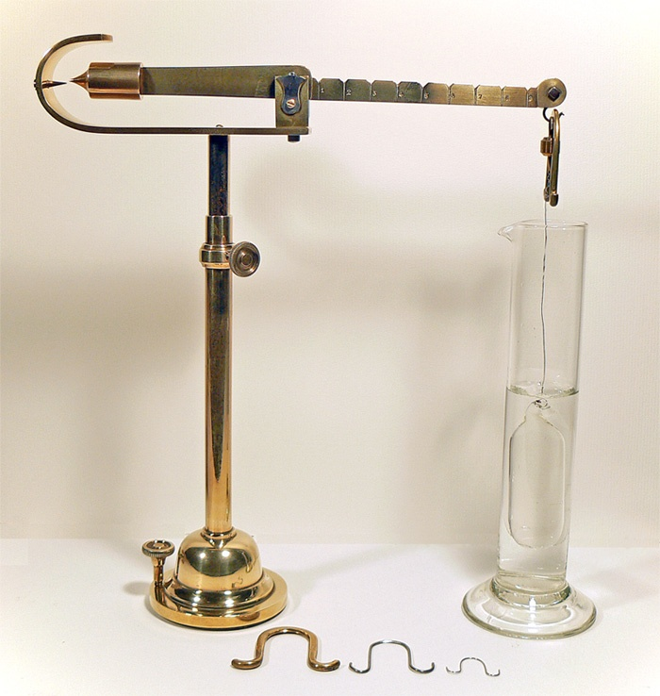
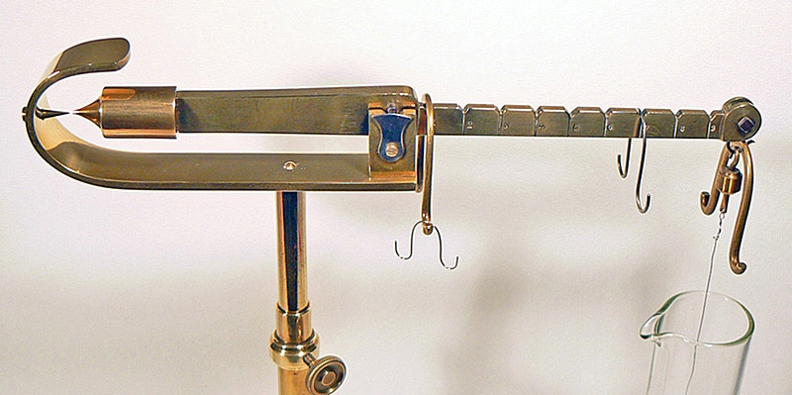

Slide 20
Specific gravity of fat and oil are affected by :
Age
Adulteration
purity
Rancidity (sp.gr. Increase with rancidity)
The different values of sp. gr. obtained with different oils are due to different composition of fatty acids

Slide 21
Sp.gr. | Fat or oil
0.936 | Butter fat
0.926 | Coconut oil
0.916 | Olive oil
0.922 | Cotton seed oil

Slide 22
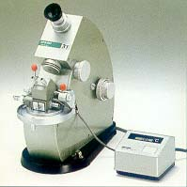
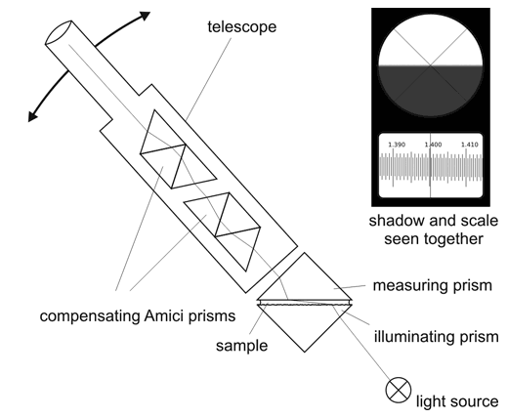
Refractive index
Measured by Abbe refractometer
at standard temp. 40 c fat
20 c oil
If the temp. is not standard correct the result as:
R.I. of fat at 40c =
R.I. obtained + 0.00053 x (temp. of fat- 40)
R.I. of oil at 20c =
R.I. obtained + 0.00053 x (temp. of oil - 20)

Slide 23
N.B:
R.I. with increase unsaturated fatty acid.
R.I. with rancidity.
Ref. index | Fat or oil
1.44 | Butter fat
1.46 | Sesame oil
1.47 | Cotton seed oil

Slide 24
Melting point
Determined by Standard open capillary tube
Procedure:
Introduce a very small amount of melted fat
(1cm long) in the capillary tube by suction.
Then cool the tube at 15˚c for 16 h.
Attach it to a thermometer by rubber band

Slide 25
The tube is then suspended in a beaker of
distilled water.
Then water is heated at a rate of about 2ᵒC/min until the fat became clear and transparent liquid.
The temp. at which the fat become transparent liquid is taken as the melting point.

Slide 26
Slip point:
the temp. at which the melting starts is called slip point.
Melting point of butter fat = 32˚c
Melting point of animal fat = 45 - 50˚c

