Slide 1
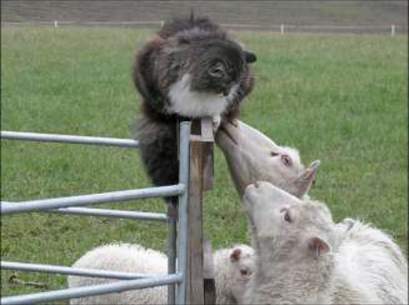
Toxoplasmosis

Slide 2
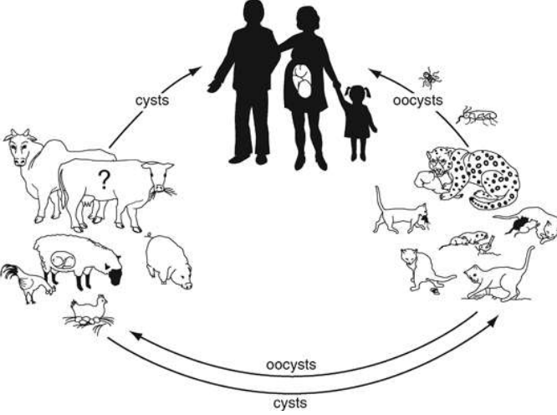

Slide 3
Toxoplasma gondii was first discovered in 1908 by Nicolle and Manceaux, in Tunis, on a Gundi (Ctenodoactylus gundi).
It wasn't until 1939 that Wolf, Cowen and Paige were to conclude that Toxoplasma gondii had an effect on humans.

Slide 4
Protozoal disease caused by Toxoplasma gondii is a protozoan parasite that infects people and other warm-blooded animals, including birds and marine mammals.
Cats are only known definitive hosts.
Animals and man I.M hosts asexual proliferation

Slide 5
Etiology
Toxoplasma gondii, an obligate intracellular protozoan parasite
Sexual and asexual life cycle
Sexual phase intestinal cells cats
Asexual phase I.M (man & animal)
It requires more than one host species to
complete its lifecycle
It is primarily an intestinal parasite in cats and
has a wide host of intermediate hosts including
sheep and mice.
One cat shedding oocysts can provide enough
contamination to infect an entire flock of sheep

Slide 6
The parasite has got affinity for epithelial,
reticuloendothelial and blood cells. The
organism could be grown in monolayer of lamb testicular cells

Slide 7
It develops through three basic life forms:
• Oocyst (sporozoite)
▫ Double layered egg found in the feces of young cats that
survives for long periods
• Tachyzoite
▫ Rapidly multiplying tiny parasite found in different cells
of the body and the cells burst releasing it into the
bloodstream
• Bradyzoite (tissue cyst)
▫ Dormant stage found in cysts of the muscle, nervous
tissue and placenta
• Unique stage is found in the feline family
▫ The cat becomes infected from eating oocysts or an
animal cyst containing bradyzoites. The parasite invades
the intestines , mate and produce millions of offspring.
The offspring are then excreted as immature oocysts in
the feces

Slide 8
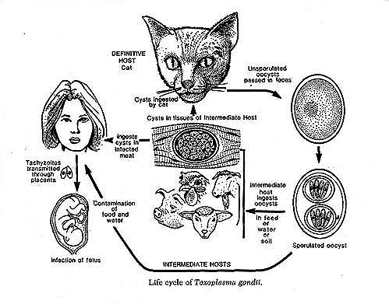

Slide 9
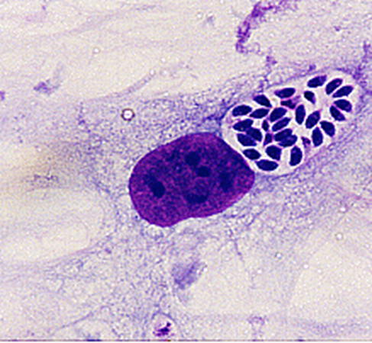
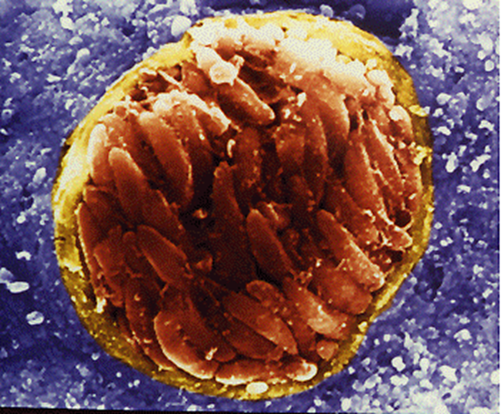
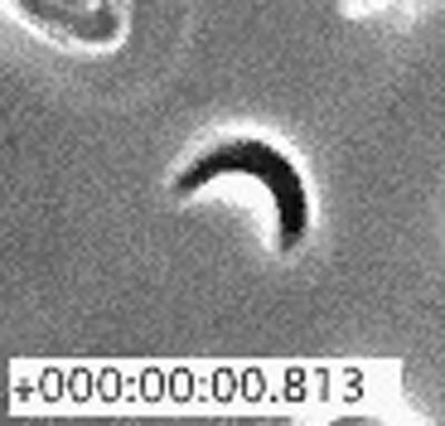
There are three forms of Toxoplasma gondii
Tachyzoite – Rapidly reproducing form
Bradyzoite – A slower reproducing form, contained in tissue
Sporozoite – Contained in oocysts

Slide 10
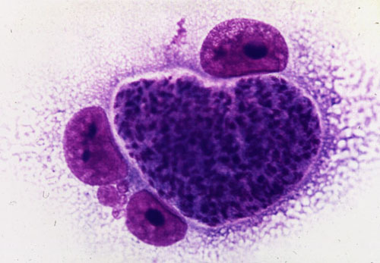
Tachyzoite
Tachyzoites invade cells in the body in order to multiply. They invade a cell, multiply themselves, destroy the cell, and this releases more tachyzoites to infect other cells.
Tachyzoites are seen in many tissues and organs throughout an infected body during the acute phase of the disease.
The acute phase is also called the extraintestinal phase because it can effect cells outside the intestines.
Only cats show the intestinal phase of the infection.
Stained tachyzoite

Slide 11
Bradyzoites
Two or three weeks after the first infection, the Toxoplasma microorganism begins to divide more slowly and a protective membrane forms around the parasite cells.
The cysts containing the parasite cells are called zoitocysts and the cells inside the cysts are called bradyzoites.
The tissue cysts are formed primarily in brain, eye, heart muscle, and skeletal muscle.
Bradyzoites persist in tissue for many years, possibly for the life of the host.

Slide 12
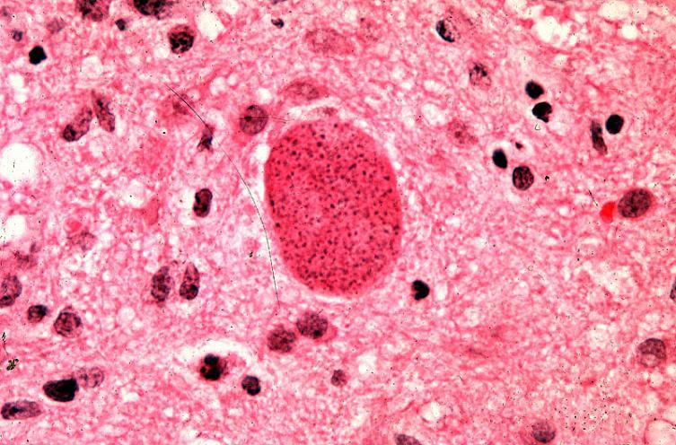
Bradyzoite

Slide 13
Oocysts
In cats, the Toxoplasma parasites infect the lining of the small intestine where they reproduce asexually.
After a few days of rapid reproduction the cells transform into a sexual form, combine, and become enclosed in a cyst called an oocyst.
Oocysts contain the sporozoite form of the Toxoplasma parasite.
Oocysts are found in both wild and domestic cats but not in any other animals or birds.

Slide 14
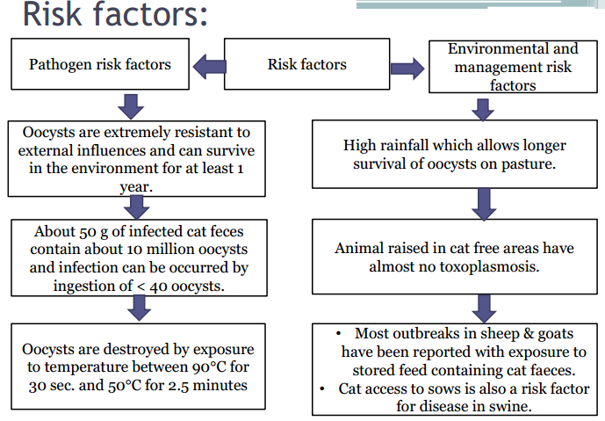

Slide 15
Economic importance
Abortion and neonatal mortality in sheep and goats (ovine abortion)
Zoonotic importance: AIDS :Meningioencephalitis
Tachyzoites: foetus transplacentally
Women from accidental ingestion of oocyst from cat faeces.

Slide 16
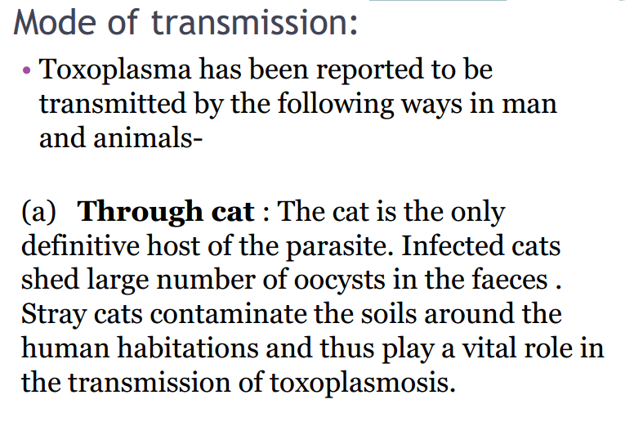

Slide 17
(b) Meat & meat products :
Consumption of raw or under cooked meat or
meat products are important source of
toxoplasmosis.
(c) Congenital infection :
From infected mother ( dam ) to the fetus

Slide 18
(d) Other methods:
• Inhalation and ingestion of infected milk
may transmit the infection.
• Infection has been traced to be transmitted
through semen.
• Experimental transmission can be made by
intramuscular , subcutaneous or
intraperitonial inoculation of infected
materials.

Slide 19
Toxoplasmosis is zoonotic
Transmission can occur in 3 ways
  Fecal-oral
  Eating contaminated meat/prey
  Transplacental
The parasite can only produce oocytes (or eggs) when infecting a cat. The organism then multiplies in the wall of the small intestine and produces oocysts during the intraintestinal infection cycle.

Slide 20
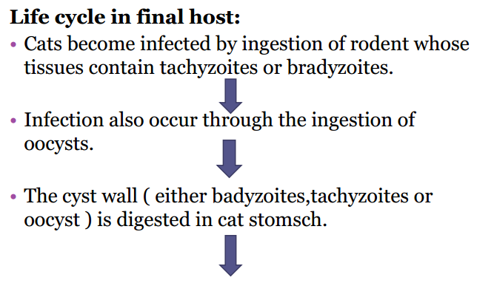

Slide 21
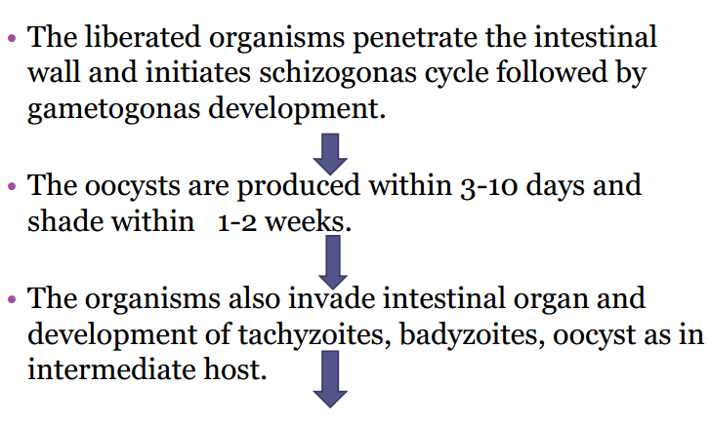

Slide 22
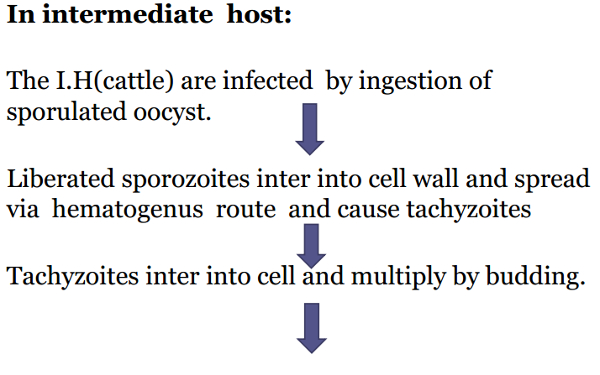

Slide 23
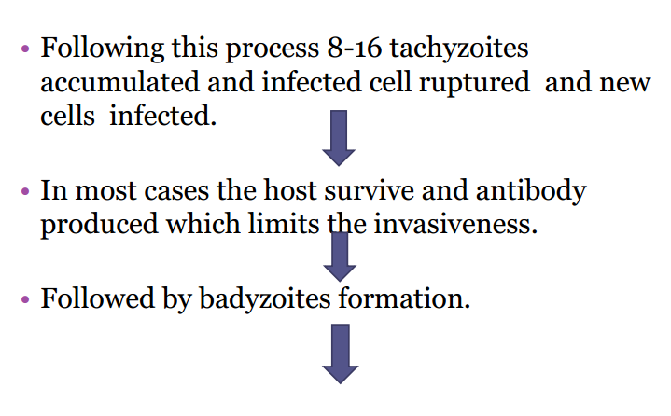

Slide 24
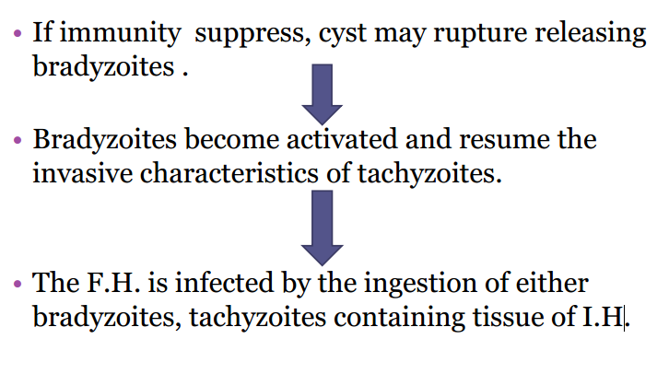

Slide 25
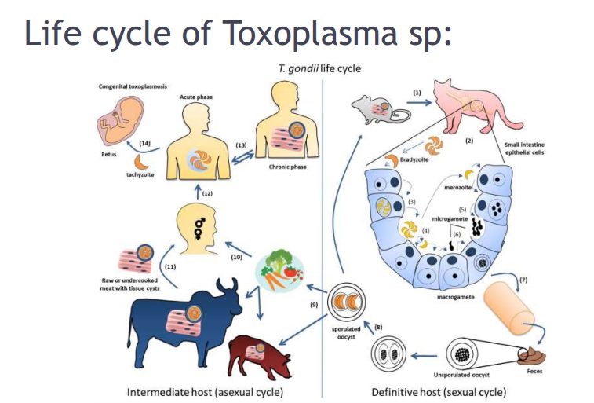

Slide 26
Cats generally develop immunity after the initial infestation, therfore, only shed oocysts once in their lifetime.

Slide 27
Clinical findings :
• Cattle and buffalo- high rise of
temperature and enlargement of lymph node.
• Sheep - abortion in ewes.
• In goats- high rise of temperature,
dyspnea, diarrhea, muscular tremors,
paresis of hind quarters, erythropenia and anemia.

Slide 28
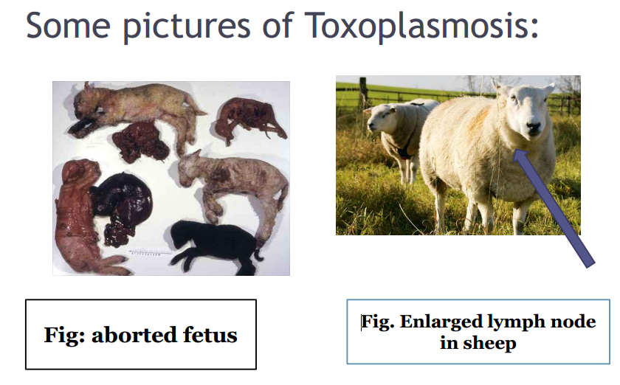

Slide 29
In puppies and kittens, tachyzoite spread systemically and cause interstitial pneumonia, myocarditis, hepatic necrosis, meningioencephalomylitis, chorioretinitis, lymphadenopathy and myositis.
Man and animal: parasitemia 5 days
Congenital: encephalitis
Post-natally: enterocolitis, pneumonitis.
Characteristic granulomatous lesions (hypersensitivity reaction)
Multiple necrotic foci (placenta)
Still birth, weak and die

Slide 30
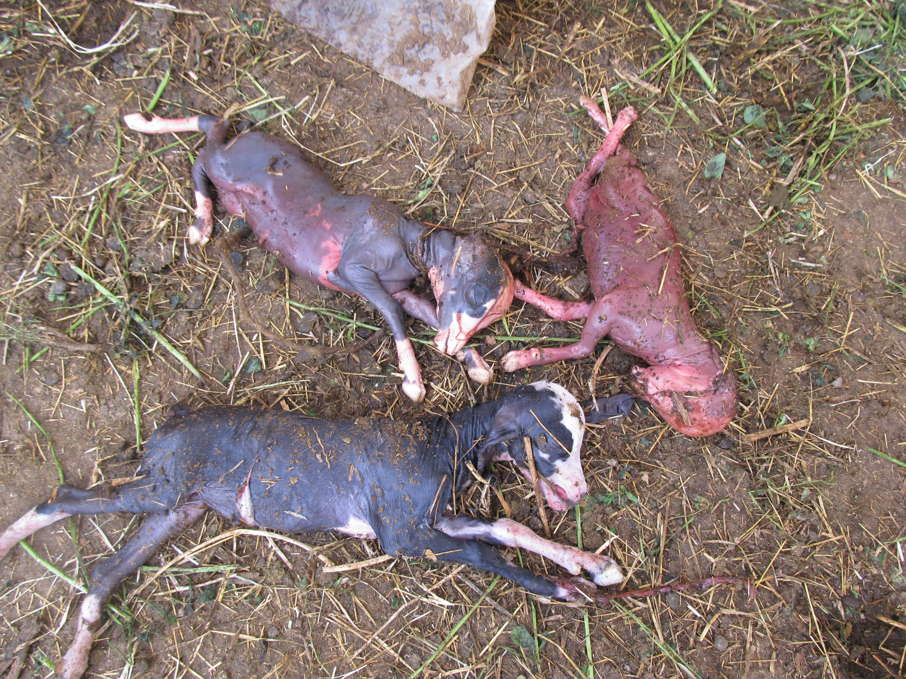

Slide 31
Diagnosis
• Clinical signs are non- specific and organism is difficult to demonstrate. Therefore,
diagnosis in man and animals is
accompanied by serological tests.
(a) Isolation of T. gondii – Parasites can be demonstrated from lymph fluid, placenta, cotyledons and muscles.

Slide 32
(b) Methylene blue dye test: Sabin and
Feldman first described it.
• This test now a days is carried out by in
microtitre plates and can be judged by
employing empty microscope.

Slide 33
(c) By complement fixation test(CFT).
(d) By indirect hemagglutination
tests(HI).
(e) By direct agglutination tests.
(f) By fluorescent antibody tests(FAT).
(g) By enzyme linked immuno sorbent
assay (ELISA)
(h) By DNA test.

Slide 34
IgM: early- 3 mo- IgM titre > 1:256 recent infestation.
IgG: 4th week- years subclinical infestation
Must be measured in paired sera from the acute and convalescent stages (3-4 weeks apart) and must show 4-fold increase in titre.
CSF: tachyzoites or antibodies.
Tissue impression smears (tachy and brady)

Slide 35
Mouse inoculation: homogenates from tissue samples, I.P, mice
Giemsa stained peritoneal fluid or squash preparations of mouse brain
Immunohistochemistry: formalin fixed materials

Slide 36
Treatment
(a)There is no satisfactory treatment. Drugs
like pyremethamine and sulphonamide are
effective.
3 days for 3 periods with intervals of 5 days between the start of each treatment.
Clindamycin for dogs and cats, at 10-40 mg/kg and 25-50 mg/kg respectively for 14-21 days.

Slide 37
control
Control programme may be aimed based on three
methods-
a) Epidemiological control-
• Lowering of cat population in endemic
zones.
• Cat should not be allowed to feed raw meat.
• Cat faeces should be properly disposed through burning.
• Hands should be properly cleaned with soap
after handling of raw meat.

Slide 38
Pregnant lady should not handle soil and raw meat.
Raw meat should not be consumed.
(b) Chemotherapeutical control- Prophylactic measures should be taken with drugs shown in treatment.
Monensin 15 mg /head per day during first 100 days of gestation (reduce lamb loss) experimentally.
(c) Control by immunization- No fruitful
vaccine is available. A vaccine containing T. gondii
used to control disease.

