Slide 1


Dried milk (Milk powder)
Produced by removal of water from milk.
Water must not be more than 5%.
Composition | Fat | Protein | Lactose | Ash | Water
Dry whole milk | 26.3% | 26.4% | 38.0% | 6.0% | 2.3%
Dry skim milk | 0.7% | 36.0% | 51.0% | 8.1% | 3.0%

Slide 2
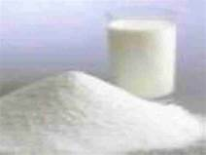
Manufacture of milk powder
1- Roller method.
2- Spray method.

Slide 3
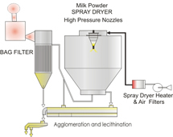
Spray method
1- Preparation of milk.
2- Pasteurization process.
3- Condensation process (40%TS).
4- Drying process.
packaging

Slide 4

Roller method
1- Preparation of milk:
2- Pasteurization process.
3- Condensation process (20% TS).
4- Drying process.

Slide 5
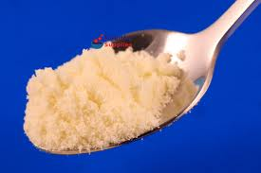
Properties of dried milk
Color: Normally white, yellow
Hygroscopic property: taking up moisture from humid air.
Solubility: It is the degree of dry milk dispersing in water

Slide 6
A- spray and vacuum dried milk
1- Readily disperses in water and no sediment is formed.
2- Passed through filter paper.
B- Roller dried milk powder
disperses very slowly and sediment is present in large amount on filter paper.
Keeping quality: spray milk powder has a longer keeping quality than roller dried m. p..

Slide 7
Defects in milk powder
Fishiness (fishy flavor)
Due to oxidation of lecithin in milk powder containing high moisture content.
Rancidity
Due to improperly heating, where lipase enzyme is the cause of this defect.

Slide 8
Lumpy condition
Due to high moisture content above 5%, where the powder becomes in the form of hard lump.
Stale flavor
Due to high moisture content and the changes occur in protein by galactase enzyme.

Slide 9
Light brown color & Cooked flavor
tallowness: in full cream milk powder dueto oxidation of fat.

Slide 10
Microbiology of dried milk
Sources
Raw milk : Thermoduric bacteria
Growth during processing :
Mesophilic : Group D streptococci (Streptococcus durance is the dominant species).
Staph. aureus may grow.
Thermophilic bacteria (Bacillus Stearothermophilus var calidolactis)
Accidental contamination in the dairy by Enterobacteriaceae (E. coli) and Staph. Aureus.
As a result of heat used in its manufacture, milk powder may transmit only diseases of human origin. This may be due to contamination from direct human contact, air borne contamination during drying, cooling, transportation and packaging.

Slide 11
Thank You

