Slide 1
Examination of non pregnant animals

Slide 2
Aims of rectal palpation
To know the normal shape and size of different genital organs of different species which help in differentiating the normal and pathological specimen
Per-rectal examination is the only practical diagnostic method permitting direct examination of genital organs of a cow, buffalo and mares. However in small animals genital organs are examined via abdominal palpation or by ultrasonography
Rectal palpation is one of the important method for pregnancy diagnosis

Slide 3
Restraint and clothing
The animal to be examined should be restraint
The cow &buffalo: can securely restraint in chute
When this is not available the hind legs should be tied
Mares :are usually tied both hind lids with one fore leg using rope , twitch on lower lip,ears nose or lifting one fore leg
Female camel: examined in sitting postion with both hind and fore legs tied together with rope
The examiner must wear proper clothing and sufficient lubrication used before introducing the hand in rectum

Slide 4
Precaution during rectal palpation
1)Avoid palpation during peristaltic wave
2)Examiner must trim their nails and avoid using dirty soiled sleeves
3)Avoid rectal palpation without asleeve specially in mares to avoid contacting disease
4)Avoid rectal palpation of animal suffering from fever
5)Rectal palpation in buffalo must be gentle as the rectal mucosa is more fragile and bleed easily
6)Avoid un careful palpation of the uterine horn can cause rupture of the amniotic vescile and loss of an early pregnancy

Slide 5
Important fact:-
The cervix which is ahard round to oval disfigured structure is the land mark.for location of genital structure in cattle & buffaloes.
In the mare the cervix is not easily palpable and hence the ovaries are the land mark for rectal palpation.they are located about 5:10 Cm below the lumbar vertebrea in non pregnant &early pregnancy
Feature of Genitalia of female camel is the shortness of the right uterine horn

Slide 6
PROCEDURE AND PRECAUTIONS:
1. Nails should be properly trimmed and rasped.
2. Finger rings, wrist-watch should be removed to avoid
injury to rectal mucosa.
3. Wear protective clothings gloves and gumboots.
4. Apply lubricant over the glove.
5. Restrain the animal properly in a crate.
6. Hold the tail of animal resting on its back.
7. Clean the perineal and vulval region with water.
8. Lubricate the anal sphincter by putting index finger and dilate
it.
9. Now put all fingers with index fingers making a cone shape of
the hand and insert it for the examination.

Slide 7
10. Remove the faeces (back-racking) without removing the hand out of the rectum to avoid rectal ballooning by sucking of air in it.
11. If ballooning occurs, reduce it by gentle pinching the rectal floor at its anteriormost folds.
12. Do not examine during peristaltic wave of rectum and/ or when the animal is straining is present
13. Avoid force during examination.
14. Insert hand up to pelvic brim.
15. Locate the cervix as a firm tubular structure approximately 25cm from the anal sphincter.

Slide 8
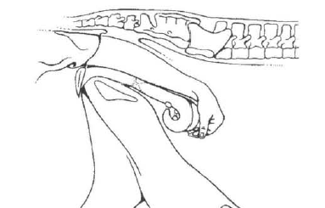

Slide 9
16. Hold the cervix between thumb and index finger and examine its physio-pathological status including external os.
17. Examine the body of uterus which is in continuity of cervix.
18. Anterior to the body of uterus, there is false bifurcation of uterine horns attached with intercornual ligament. If needed, retract the organ for examination
19. Put middle or index finger between the two uterine horns and locate the intercornualligament
20. Palpate both the uterine horns one by one by digital pressure
from base to tip to know the physio- pathological conditions like its symmetry, tonicity and for content (like pus) ).

Slide 10
21. Ovaries are located by the side of tubular organ-laterally almost near to the tip of uterine horn or at the level of uterine
Bifurcation.
22. Hold the ovary between middle and index finger and palpate by thumb for presence or absence of functional structure over the ovary.
23. Fallopian tubes are normally not palpable except in pathological condition.

Slide 11
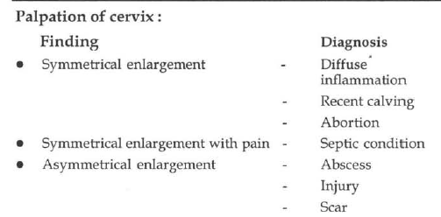

Slide 12
Palpation of uterus:
Commonly used terms for characterizing uterine tone and condition of uterine tissue
• Estrus: tone - A turgid, contracted uterus that is often curled
during palpation.
• Thickened (doughy) - A pathological condition, indicating thickning of the endometrium and myometrium.
• Fluctuant - Uterus with intraluminal fluid.
• Firmness - Chronic inflammation or neoplasia.

Slide 13
Palpation of ovary :
• Vesicles can be felt on the bovine ovary at all stages of the
reproductive cycle.
• A vesicle with a thin wall, 1.5 cm. in diameter (sometimes up to 2.5 cm. diameter) and accompanied by pronounced contractibility of the uterus will be mature Graafian follicle of oestrus
• Mature Graafian follicle is frequently found towards the end of first half of the oestrous cycle i.e. first wave of follicle formation.
At this stage either ovary also bears large corpus luteum, which is not usually present during oestrus.

Slide 14
Between the 2nd and 5th (6th) days of the cycle, there are neither vesicles nor solid structures (corpus luteum). This appearance
can be confused with an inactive ovary. For this, re-examine the
animal few days later.
• A small, soft, periodic corpus luteum can be felt from the 5th day
of the cycle onwards.
• Most CL have a papilla or crown like projection or neck above
the surface of the ovary.
• Corpus albicans are small and very firm structure which can be
differentiated from fluctuating structure of Graafian follicles

Slide 15
Vaginal examination
:Vaginoscope
Aim :
1. Visualization for vagina.
2. Examination of vagina.
3. For certain case of infertility .
4. For collection of vaginal swab (for bact. Examination ) 5. Used with cervical technique with AI

Slide 16
Technique :
– Sterilization vaginoscope by firing .
– Lubricate vaginoscope by paraffin oil or vaslin .
– Take two vulval lips apart and insert vaginoscope firstly upward (to avoid suburetheral diverticulum & external uretheral orifice )
– Then direct it forward and turn vaginoscope and gradually open it to visualization , examination m.m and porchovaginalis .

Slide 17
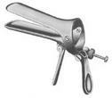
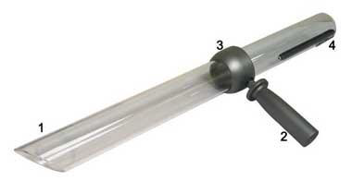
Types :
1. Metalic .
2. Glass prespex
3. Vaginal opener

Slide 18
Finding :
– Mucous membrane of vagina :
– Rosy red color : during estrous ( normal )
– Light red color : during diestrous
– Pale m.m : at under feeding anestrum
– Congested red m.m : in vaginitis
– Cervical mucous :
– At estrous : clear & transparent .
– At diestrous : dry mucous membrane
– In vaginitis : turbid or pus on m.m .
– Examination of :
– Acquired problems : as vaginitis , abscess or tumer .
– Conginital problems : as double porchovaginalis or flesh piller .
– Portiovaginalis:
Opened: duning estrous.
– Closed: during diestrous.
– Rose shape: inflammation

