Slide 1
II- SALIVARY GLANDS

Slide 2
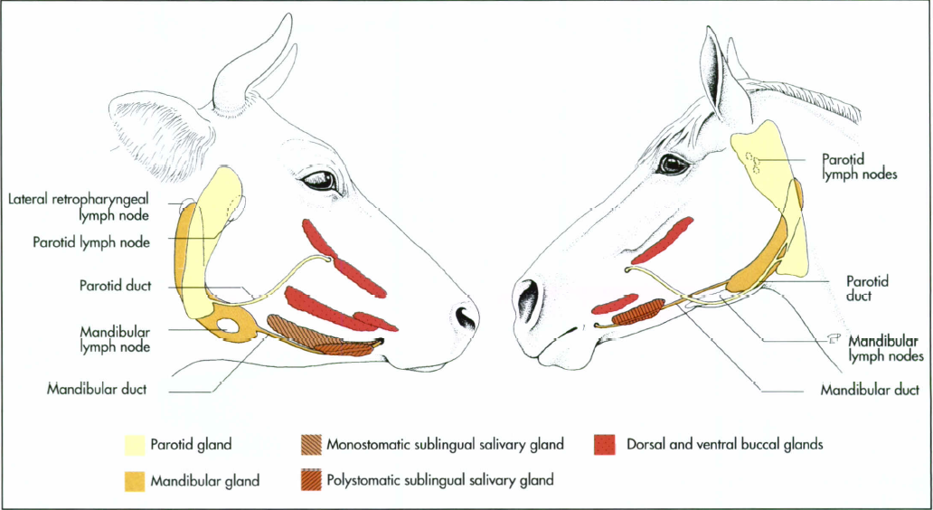

Slide 3
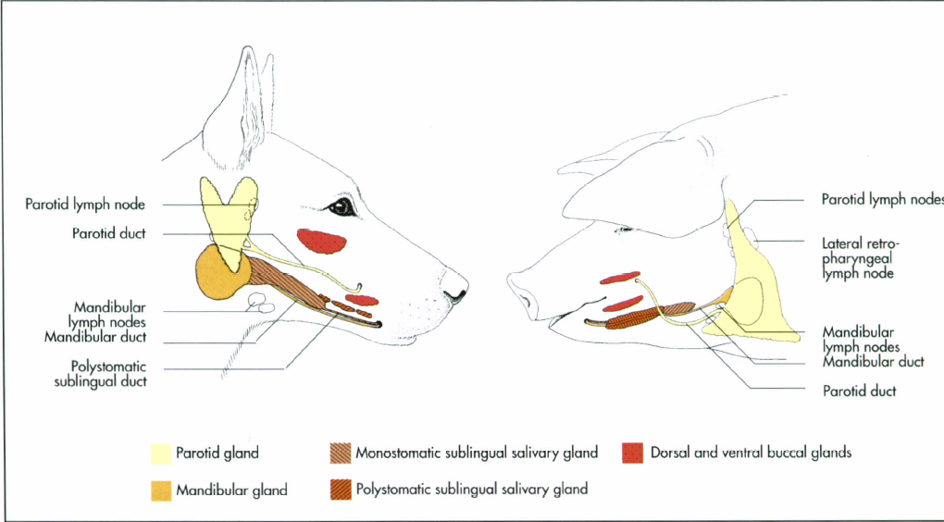

Slide 4
I-SALIVARY MUCOCELE (SIALOCELE OR SALIVARY CYST)
Salivary mucocele is a collection of saliva that leaked from a damaged salivary gland or duct,
It lined by inflammatory tissue (called granulation tissue)
Salivary mucocele is the most common salivary gland disorder of dogs but are very rarely in cats.
the sublingual and mandibular glands are involved most commonly.

Slide 5
Salivary mucocele may be classified as follows:
Cervical Mucoceles
Sublingual Mucoceles (Ranula)
Pharyngeal mucoceles

Slide 6
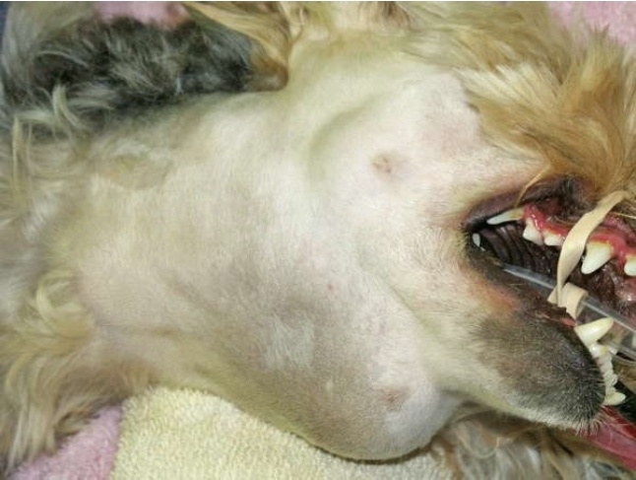
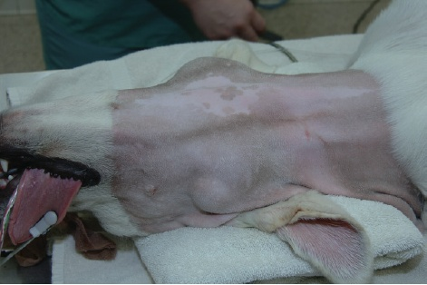

Slide 7
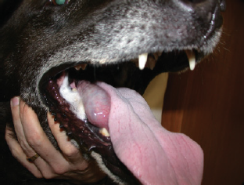
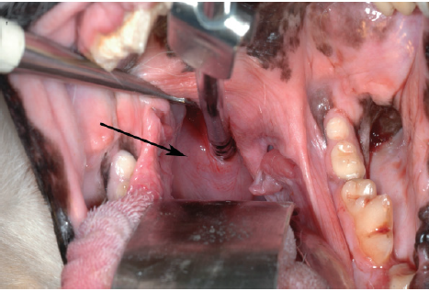

Slide 8
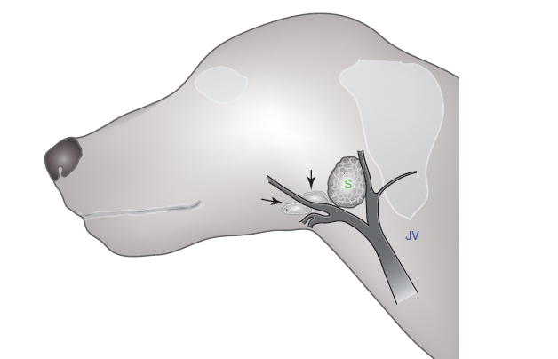
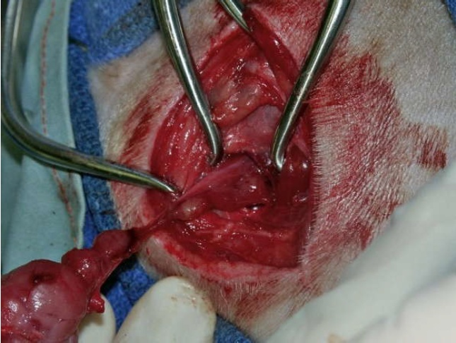
EXCISION OF MANDIBULAR & SUBLINGUAL GLANDS

Slide 9
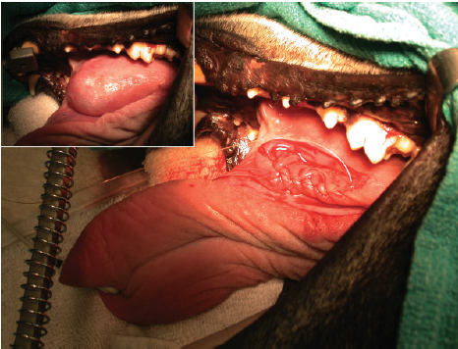
Marsupialization

Slide 10
II-SALIVARY CALCULI (SIALOLITH)
The parotid duct is the most commonly involved.
Sialolith is seen more often in equines and also recorded in cattle, dogs and camels.
The sialolith is formed of an organic nucleus, surrounded by concentric layers of calcium phosphate crystals.

Slide 11
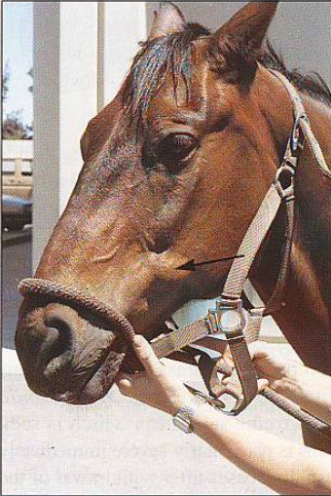
Signs
Diagnosis
Treatment:

Slide 12
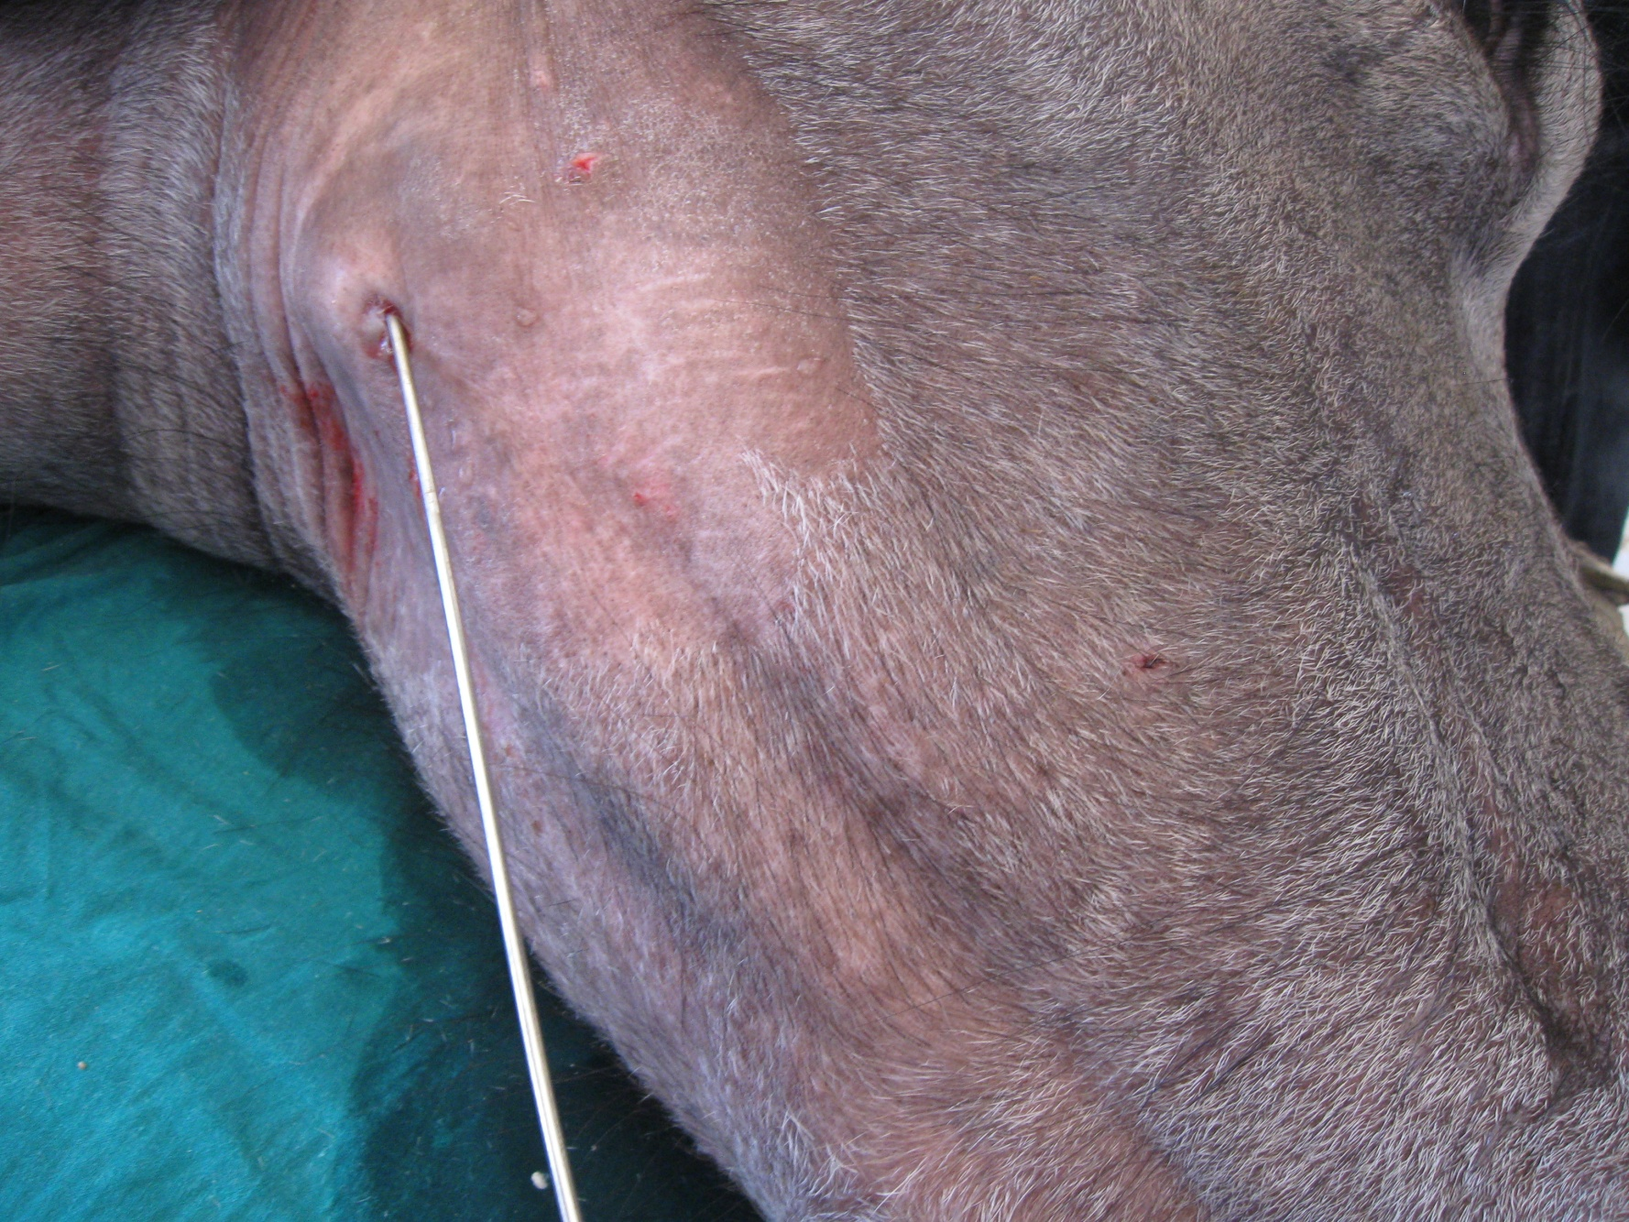
III-SALIVARY FISTULA

Slide 13
Signs
Diagnosis
Treatment
Repair the fistula
Creation of intra- oral fistula (marsupialization)
Destruction of the function of the gland

Slide 14
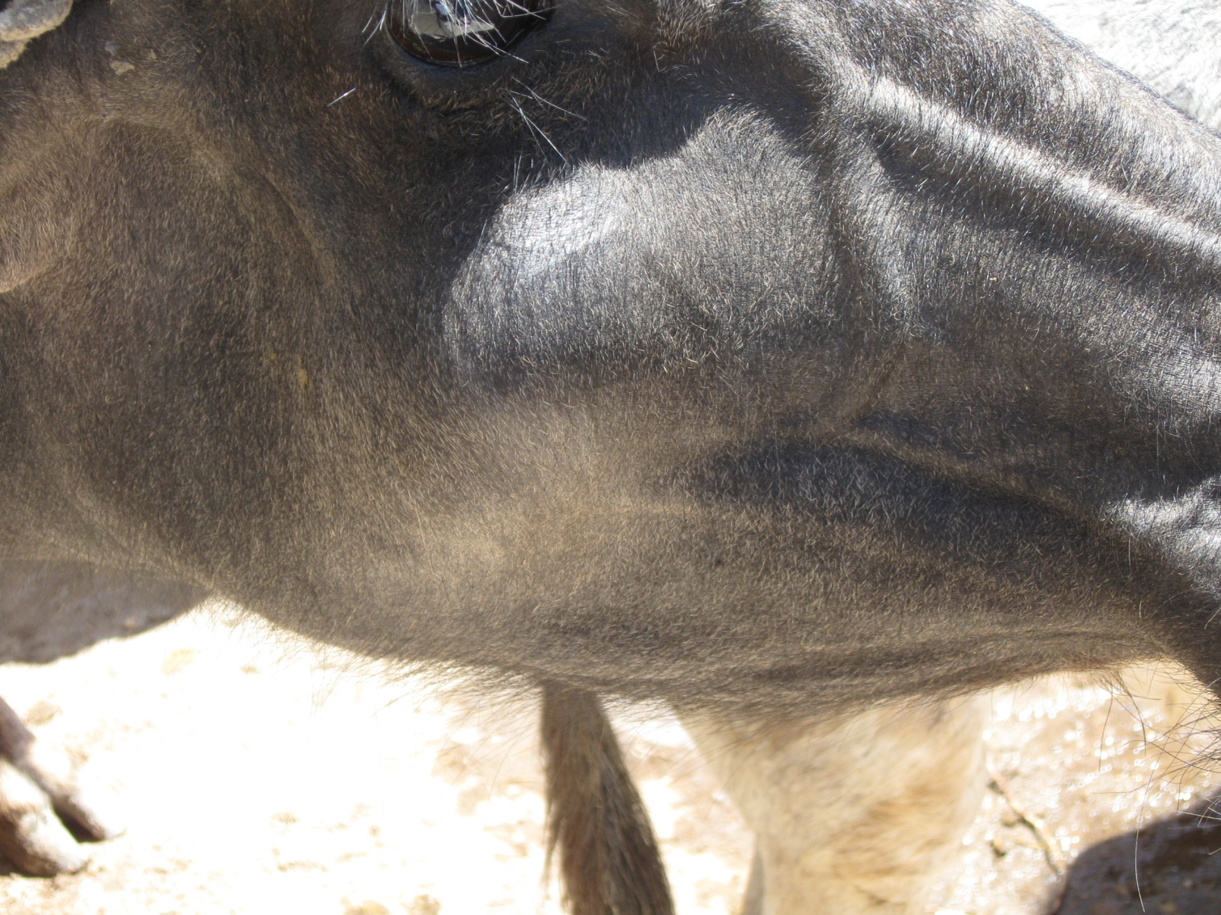
IV-ECTASIA OF THE PAROTID DUCT

Slide 15
Causes: -
Congenital
Obstruction
Scaring of the orifice at the papilla
Signs: -
1-The duct is dilated
2-The swelling is soft and having the consistency of engorged vein
3-The dilated duct may reach the fest size in buffaloes

Slide 16
Treatment:
pass a probe through the orifice of the duct
Incision of the narrow orifice with special scalpel
Creation of artificial intra-oral fistula (marsupialization):

Slide 17
V- SIALADENITIS
Cause: -
Trauma from penetrating wounds
Systemic infection
Systemic viral disease as canine distemper
Retrograde infection through the parotid duct

Slide 18
Signs:
Fever, depression, and painful, swollen salivary glands
Rupture of an abscessed gland discharges pus
Rupture through the skin may cause a salivary fistula to form
Treatment:
Abscess should be drained
Systemic antibiotics

