Slide 1
DIGESTIVE SYSTEM
I- ORAL CAVITY

Slide 2
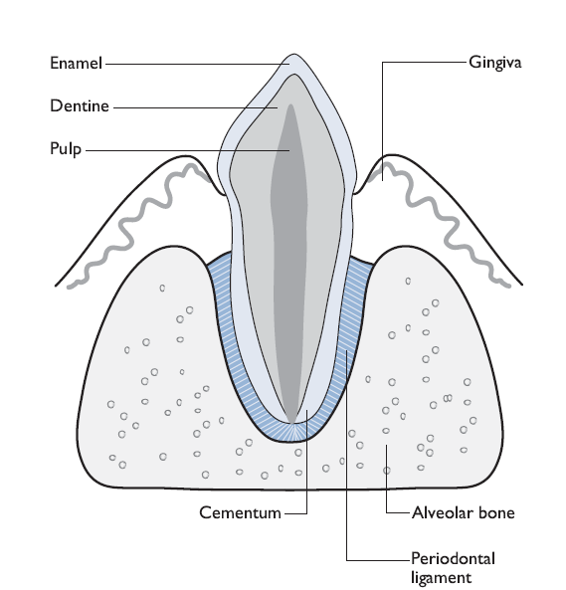
I-DENTISTRY

Slide 3
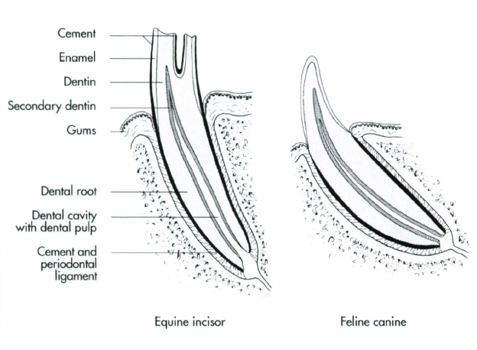

Slide 4
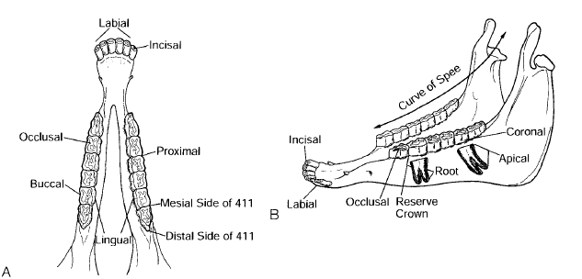

Slide 5
1-CONGENITAL ANOMALIES OF THE TEETH

Slide 6
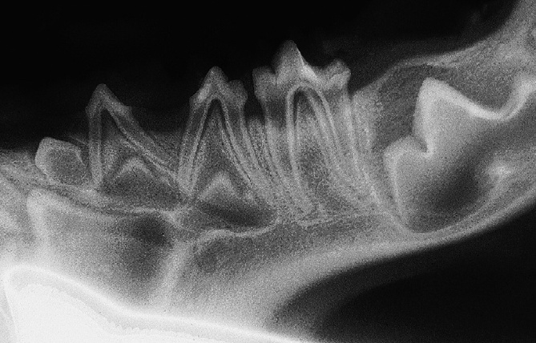
B- Oligodontia
1-Pseudo-oligodontia
2-True Oligodontia

Slide 7
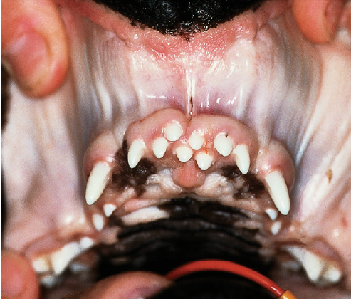
C-Polydontia (supernumerary teeth)
Pseudo- or true
Clinical signs
Treatment

Slide 8
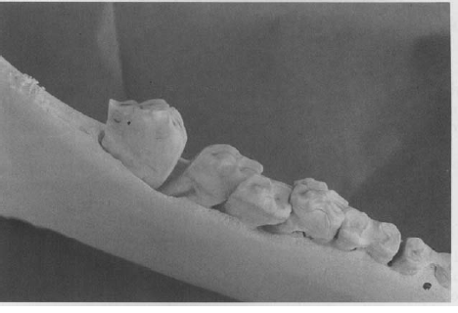
D- Diastasis Dentium (Diastema)
It is frequently observed in horses, donkeys, and dogs and less common in cattle

Slide 9
Causes: -
1-Congenital causes
Failure in the position of the tooth bud during embryonic stage of
Torsion or rotation of the tooth during development
supernumerary
2-Developmental causes
Retention of one deciduous tooth
Impaction of one permanent tooth
Extraction or missing of one tooth
Clinical signs
Treatment

Slide 10
2-DEVELOPMENTAL ANOMALIES OF THE TEETH

Slide 11
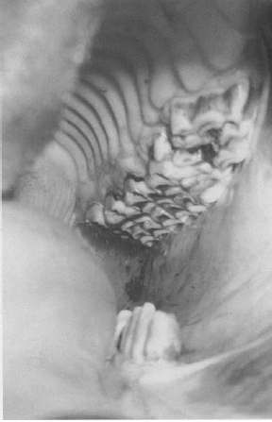
A-Sharp Enamel Points (sharp teeth)
Causes
Signs
Treatment

Slide 12
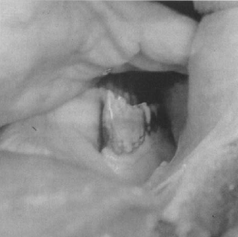
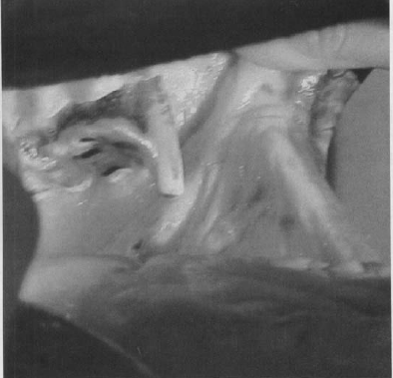
C-Projection Of The Tooth (Hooking)

Slide 13
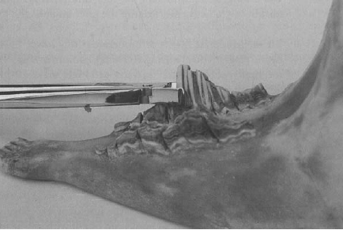
D-Elongation of Tooth (Exsuperantia dentium)

Slide 14
3- DISEASES OF THE TEETH

Slide 15
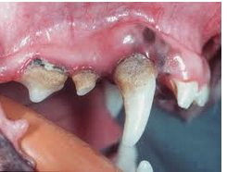
A-Dental Tartar Or Dental Calculi (Odontolithiasis)
It is a salivary concretion that accumulates on the dental surfaces

Slide 16
Causes
Soft and convenient diets
The first stage in the formation dental plaque. consists of food debris, leukocytes, microorganisms and desquamated epithelial cells.
The second stage is mineralization of the dental plaque. through calcium and phosphorus salts present in the saliva.

Slide 17
Signs
Offensive fetid bad breath
Gingivitis
Periodontal disease
Dental calculus varies in color from grayish-white to grayish –brown.
It has a rough surface which encourages further build-up of plaque.
The common seats of calculus formation are the lingual surface of the incisors especially that of the lower jaw, around the canines and the buccal surfaces of premolar and molar teeth.

Slide 18
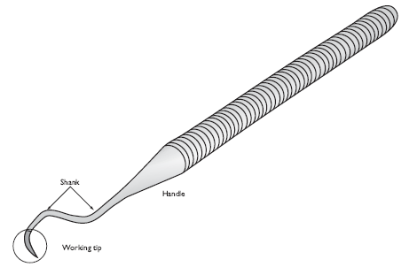
Treatment: -
Hand or mechanical scaling:
Large calculi can be dislodged
washed with mild antiseptic solution
The stains of the teeth are removed by using 3% H2O2 or 1% HCl.
Inflamed gum is swabbed with Tr. of iodine or glycerine/iodine combination.
Dogs must be given raw meat and bones.
Periodical brushing

Slide 19
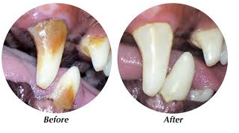

Slide 20
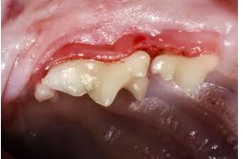
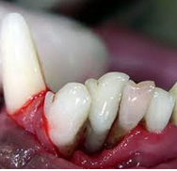
B-Periodontal Disease inflammation and/or degeneration and destruction of the soft and hard tissue which surrounds and supports the teeth.

Slide 21
Dental tarter
M.Os
Recession of gum
protease, collagenase and elastase enzymes
Peidontal pockets

Slide 22
Signs
Bad breath, yellow teeth and facial swellings
Gingivitis and ulceration
Recession of the gum
Tooth mobility
Osteoclastic resorption of the alveolar bone
Abscessation
Pulpitis
pathological fracture or dental fistula.
Toxins lead to endocarditis, nephritis and hepatitis

Slide 23
Diagnosis:
Clinical signs
Inspection of gingival sulcus
Radiography
Treatment:
- Professional treatment: -
scaling, polishing, elimination of any stagnation area and extractions.
Gingivectomy in case of hyperplastic gingivitis.
Systemic antibiotics
- Home care and maintenance: -
dietary and artificial oral hygiene aids by owners.

Slide 24
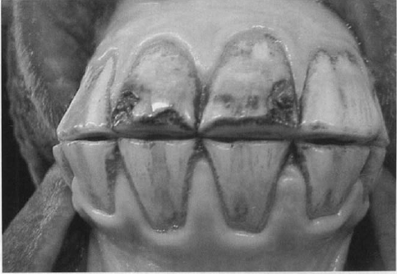
C-Dental Caries
progressive, localized and circumscribed decay or disintegration of the tooth substance with subsequent formation of a hole, which increased in width and depth until reaches the pulp cavity

Slide 25
Causes:
Small fissure and invasion of acid forming M.Os
Softening of the substance of the tooth by decomposed saliva and fermented
food materials accumulated infundibulum
Entrapment of food at the spaces between the teeth and fermentation
Hypoplasia of the enamel
Deficiency of trace elements and vitamins

Slide 26
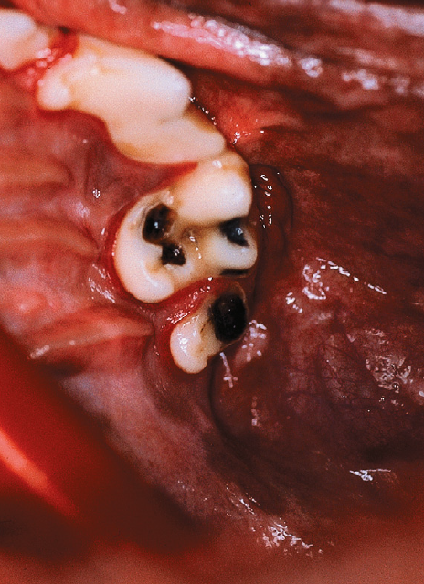
Signs:
yellow spot which changed quickly into brown or black
Formation of a hole
defects that extend to the pulp and root apex
Severe pain when drinking during mastication
Offensive odor from the mouth
Cemental or infundibular caries (cemental necrosis) develops within theinfundibulum

Slide 27
Treatment: -
Extraction
Repulsion.
filling

Slide 28
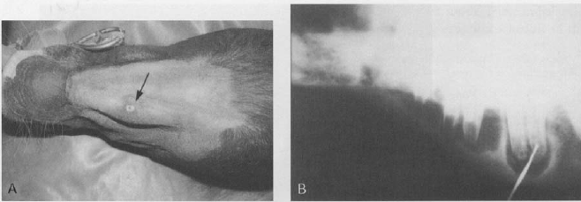
E-Dental Fistula
A purulent tract connecting between the alveolus of the affected tooth and the outside surface of the skin.

Slide 29
Causes:
Alveolar periostitis
Abscess at the root of the tooth
Clinical signs:
Fistual the level of the upper jaw in dogs and lower jaw in horses
The opening is small funnel-shaped, discharging pus with very foetid odor
Swelling of the bone and skin around the fistual opening
4-Metal probe is passed through the canal, striking the root of the tooth, and a hell-like sound is heard

Slide 30
Treatment:
Extraction of the involved tooth
Curetting of the fistula and washing with antiseptic solution
NB: Fistula resulting from a splintered fracture of the mandible or maxilla may be known as false dental fistula. characterized by:
short canal and small opening
dull sound by metal probe,
the inflammation of the bone around the opening is
slight, discharged pus is small in amount and not very bad smelling,
teeth are healthy

